Slide 1
Comments on “Are Sovereign Credit Ratings Overrated?” by Kunovac and Ravnik Comments by Ricardo Lago
June 12th , 2016

Slide 2
Mark Carney Governor of the Bank of England
“Low interest rates contributed to the gradual build-up of financial vulnerabilities in the past….It doesn’t take a genius to see that similar risks exist today.”

Slide 3
Christine Lagarde Managing Director IMF
“ There is too little economic risk-taking, and too much financial risk-taking.”

Slide 7
“And when he woke up, the dinosaur was still there” Augusto Monterroso

Slide 8
Interest rates : historical aberration ! (Yield of 10-year US Treasuries )

Slide 9
No deleveraging, debts have risen …

Slide 10
Assets are overvalued Shiller’s CAPE of the S&P 500

Slide 11
Why CAPE ?

Slide 12
Derivatives risk

Slide 14
Problem Many traders believe that zero interest rates are the normal state of nature!
Bloomberg Survey
Cognitive bias
One third of traders never experienced anything other than zero interest rates
Two thirds have no adult memory of the dotcom crash of 2000.
Behavior responds more to individual construction based on recent experience than to objective input.

Slide 15
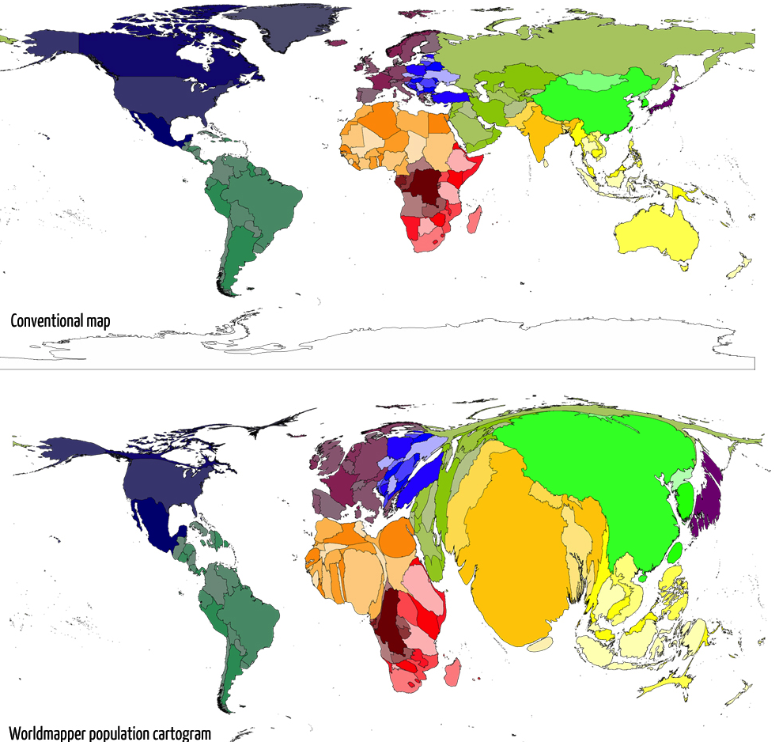
Poor growth outlook Declining dividend of integration into the world economy of China, India, Eastern Europe Goods things end…..

Slide 16
We know that only diamonds are for ever…

Slide 17
Monetary normalization Move on, do not procrastinate

Slide 18
So central banks should normalize policy, not procrastinate …

Slide 19
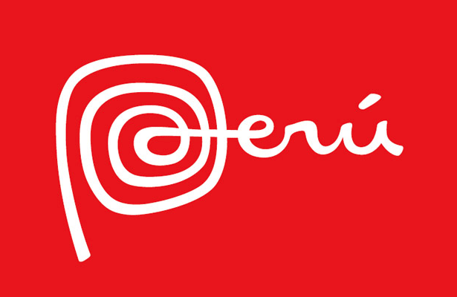
And what is right with

Slide 20
Perú: GDP performance (1991- 2015)

Slide 21
GDP still growing at 3% depite export shock

Slide 22
Vale un Perú ( Worth a Peru )
Spanish language phrase that has come to symbolize a matter of great value
https://en.wikipedia.org/wiki/Vale_un_Perú

Slide 23
Peru’s macroeconomic policy “vale un Peru” and if continued it could take the country to past hights …

Slide 24
Citations in the book The Wealth of Nations ( 1776 )
Number of paragraphs in The Wealth of Nations with the words

Slide 25
FIN

