Slide 1
Standard presentation format
3rd quarter 2022

Slide 2
Agenda
Central bank’s objectives and structure
Real sector
Monetary policy
External sector
Banking sector

Slide 3
Central bank’s objectives and tasks
Stability of prices
Supporting the general economic policies of the European Union, without prejudice to its primary objective
Management of the international reserves
Issuing banknotes and coins
Issuing and revoking licenses for banks and bank supervision
Regulating, improving and supervising the payment system
Maintaining the stability of the country's financial system
Performance of operations on behalf of the Republic of Croatia, as provided by law

Slide 4
Independence of the CNB
Institutional: decisions are reached independently of other institutions’ influence
Functional: clear by defined goal and independence in choosing the instruments and measures for achieving that goal
Personal: guarantees the protection of the Governor and the Council members from various kinds of pressure, precisely determines the conditions for the appointment and removal from office, and guards against the conflict of interest
Financial: revenues and expenditures of the CNB are solely determined by the nature of the monetary and exchange rate policies

Slide 5
Structure of the CNB
GOVERNOR
Deputy Governor
Vicegovernor
Vicegovernor
Vicegovernor
Vicegovernor
Vicegovernor
Vicegovernor
Chief Economist
Chief Operating Officer
Central Banking Operations Area
Statistics Area
Prudential Regulation and Methodology Area
International Relations Area
Legal Area
Foreign Exchange Regulation Office
Currency Area
Research Area
Controlling and Accounting Area
Credit Institutions Resolvability Assessment Office
Information Technology Area
Communications Area
Prudential Supervision Area
Consumer Protection Monitoring Office
Succession Issues Coordination Office
Compliance Office
Support Services Area
Office of the Governor
Expert Supervision and Oversight Area
Security Office
Internal Audit Office
Payment Operations Area
Visitors’ Centre
Office for Coordination of Prudential Supervision, Oversight and Risk Management Activities

Slide 6
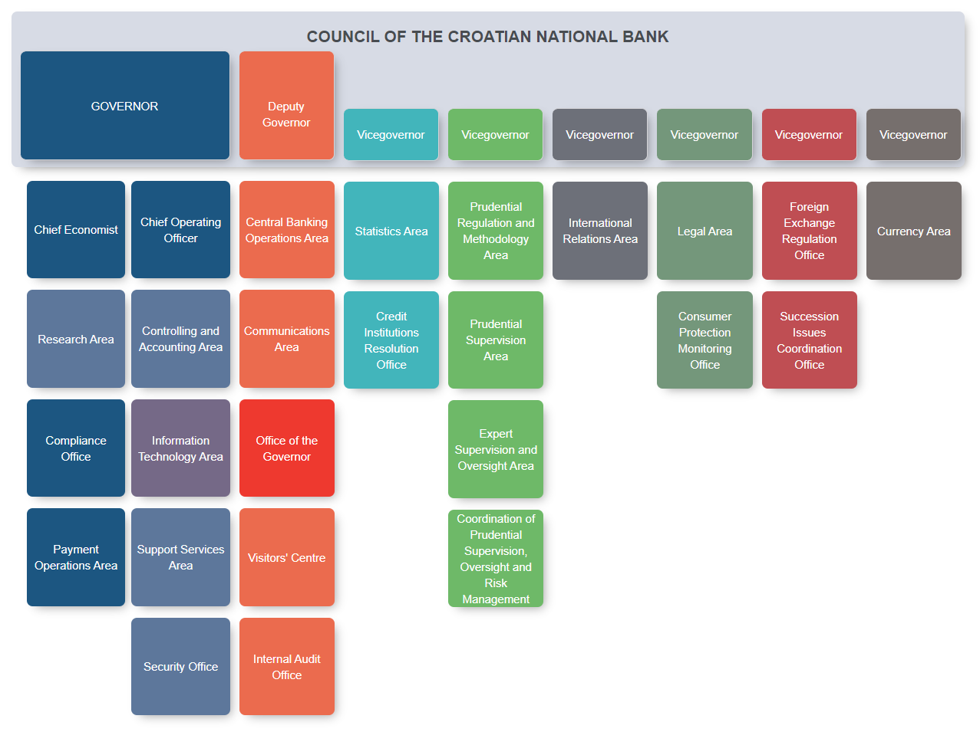
Organizational chart of the CNB

Slide 7
Real sector
  Aggregate demand and supply
  Labour market
  Prices
  Fiscal policy

Slide 8
Real GDP rates of change
Croatia
Peer countries
*The data refer to the first two quarters of 2022.
Note: The data are according to ESA 2010 methodology, from 2019 are provisional. More information can be found on www.dzs.hr.
Source: CBS.
Average annual growth rate, 2003 – 2021
Note: The data are according to ESA 2010 methodology.
Sources: Eurostat and CBS.

Slide 9
Gross value added structure
In current prices, 2022
*The data refer to the first two quarters of 2022.
Source: CBS.

Slide 10
Contributions of domestic and net foreign demand to GDP growth
*The data refer to the first two quarters of 2022.
Source: CBS.

Slide 11
Unemployment rate
Croatia
ILO unemployment rate,
peer countries, 2021
Note: Since the beginning of 2007 results from the Labour Force Survey have been published in quarterly dynamics. ILO unemployment rate refers to persons aged 15 years and over. Data on ILO unemployment rate for 2021 refers to the first three quarters.
Data on ILO unemployment rate for period 2007-2014 have been harmonised with the results of the Census of Population, Households and Dwellings in 2011,and are not comparable with data for period 2000-2006. Data for 2015 and 2016 have been revised due to availability of new estimates of the total population in Republic of Croatia. Data from the first quarter of 2021 is according to the new methodology. Data on administrative unemployment rate is revised for the period between January 2016 until December 2020.
Source: CBS.
Note: ILO unemployment rate refers to persons aged 15 – 74.
Source: Eurostat.

Slide 12
Nominal and real net wages
*Last available data is for wages paid for August.
Note: Data on average wages paid for January 2020 were reported in full-time equivalent, in contrast with the previous periods, when average wages were calculated by dividing total disbursements by the number of employees who received these disbursements, excluding all those who worked fewer than 80 hours per month.
Sources: CBS and CNB.

Slide 13
Average monthly compensation per employee in economy, 2021
Note: Average monthly compensation per employee in economy is calculated as a ratio of total monthly compensation paid to employees and number of employees.
Source: Eurostat.

Slide 14
Gross value added in industry per person employed
*The data refer to the first two quarters of 2022.
Source: CBS.

Slide 15
Inflation
Croatia
Year-on-year inflation rates and components’ contribution to consumer price inflation in Croatia
*Data for 2022 refer to January-September.
Note: CPI inflation and core inflation, average year-on-year rate of change.
Source: CBS.
Sources: CBS and CNB's calculation.

Slide 16
Inflation in Croatia, euro area and peer countries
Note: Average year-on-year rate of change. Inflation is measured by harmonized consumer price index. Data for 2022 refer to January-September.
Source: Eurostat.

Slide 17
Consolidated general government revenues and expenditures
Croatia
Peer countries, 2021
Note: According to the ESA 2010 methodology.
Sources: Eurostat and CBS.
Note: According to the ESA 2010 methodology.
Sources: Eurostat and CBS.

Slide 18
Consolidated General Government Balance
Croatia
Peer countries, 2021
Note: According to the ESA 2010 methodology.
Sources: Eurostat and CBS.
Note: According to the ESA 2010 methodology.
Sources: Eurostat and CBS.

Slide 19
General government debt
Croatia
Peer countries, 2021
Note: The data has been revised since December 2001 due to the additional harmonization of coverage of general government sector to ESA 2010 standard.
Sources: Eurostat and CBS.
Note: The data for Croatia has been revised since December 2001 due to the additional harmonization of coverage of general government sector to ESA 2010 standard.
Sources: Eurostat and CBS.

Slide 20
Monetary policy
  Central bank’s policy
  Monetary developments
  Interest rates

Slide 21
Foreign exchange interventions and exchange rate
Source: CNB.

Slide 22
Exchange rate movements before CNB intervention and amount of intervention, 2015 – 2022
Exchange rate of the intervention day relative to exchange rate 4 days prior to intervention (y-axis) and the intervention amount (x-axis).
Source: CNB.

Slide 23
Creation and withdrawal of reserve money
Note: The possibility of using Lombard credits was abolished, while the possibility of using overnight credits was introduced on 28 September 2017. Values for the regular and structural operations, as well as lombard/overnight credits are shown as change in one quarter. Foreign exchange transactions include purchases and sales of foreign currency by the CNB with credit institutions, MF, EC and swap agreements. Positive values reflect the purchase of foreign currency.
Source: CNB.

Slide 24
Reserve requirements and minimum f/c liquidity
Source: CNB.

Slide 25
Liquidity surplus and overnight interest rate
Note: Until the end of 2015 the overnight interest rate refers to the interbank overnight interest rate, while from the beginning of 2016 it refers to the interest rate on overnight interbank demand deposit trading.
Source: CNB.

Slide 26
Base money M0
Source: CNB.

Slide 27
CNB's international reserves and money supply
Source: CNB.

Slide 28
Other monetary financial institutions' assets
Source: CNB.

Slide 29
Placements to other domestic sectors
(excluding government)
Placements to other domestic sectors
Placements-to-GDP ratio
Note: One-off effects substantially decreased the stock of placements and in 2015 and 2016 they relate to partial write-off of loans to households indexed to the Swiss Franc. Source: CNB.
Sources: Eurostat, ECB, CNB and CBS.

Slide 30
Loans of other monetary financial institutions
Note: One-off effects substantially decreased the stock of placements in 2015 and 2016 they relate to partial write-off of loans to households indexed to the Swiss Franc.
Source: CNB.

Slide 31
Loans to households - structure
Source: CNB.

Slide 32
Currency structure of other monetary financial institutions' placements
Note: Loans in foreign currency include loans denominated in that currency and loans indexed to that currency.
Source: CNB.

Slide 33
Broad money (M4)
Source: CNB.

Slide 34
Euroisation
Source: CNB.

Slide 35
Average lending interest rates
Note: Details about the new interest rate statistics: Bulletin 204, June 2014 (http://www.hnb.hr/publikac/bilten/arhiv/bilten-204/hbilt204.pdf).
Source: CNB.

Slide 36
Average deposit interest rates
Note: Details about the new interest rate statistics: Bulletin 204, June 2014 (http://www.hnb.hr/publikac/bilten/arhiv/bilten-204/hbilt204.pdf).
Source: CNB.

Slide 37
Interest rate spread
* without a currency clause
** with a currency clause
Note: Details about the new interest rate statistics: Bulletin 204, June 2014 (http://http://www.hnb.hr/publikac/bilten/arhiv/bilten-204/ebilt204.pdf).
Source: CNB.

Slide 38
Yield on T-bills and kuna government bond
T-bills, bonds - average price in a month .
Sources: MoF and ZSE.

Slide 39
Bonds listed on the ZSE
Stock as at October 18th 2022
Source: ZSE.
Stock as at October 18th 2022
Source: ZSE.

Slide 40
External sector
  Exchange rate
  Foreign trade
  Current account
  External debt
  FDI

Slide 41
Exchange rate policy
Managed floating
Exchange rate is market determined and based on supply and demand
Central bank intervenes on the forex market through
forex auctions, but it does not defend any predetermined rate or band

Slide 42
Foreign exchange market
Kuna is fully convertible
No restrictions on repatriation of profits and liquidation of investments
Banks freely determine the exchange rate, engage in the foreign exchange operations and conduct international payment transactions

Slide 43
Current and capital account balance and FDI liabilities
Note: According to BPM6 and ESA 2010 methodology. The FDI liabilities data doesn’t include round tripping.
Negative values of FDI liabilities indicate inflow of FDI.
Source: CNB.

Slide 44
Structure of the current and capital account balance
Source: CNB.

Slide 45
Current and capital account balance by countries, 2021
Sources: Eurostat and CNB.

Slide 46
Daily nominal exchange rates
HRK vs. EUR, USD and CHF
Source: CNB.

Slide 47
Index of nominal and real effective kuna exchange rate
Note: The real effective exchange rate of the kuna deflated by producer prices is based on the Croatian index of industrial producer prices on the total market. The unit labour cost (ULC) is defined as the ratio of labour costs to labour productivity (expressed as GDP per employee).
Source: CNB.

Slide 48
Index of real effective exchange rate deflated by CPI
Note: The fall of index denotes real effective appreciation.
Sources: BIS and CNB.

Slide 49
Merchandise trade
Note: Seasonally adjusted data.
Sources: CBS and CNB.

Slide 50
Gross external debt by debtors
Note: According to BPM6 and ESA2010 methodology.
Source: CNB.

Slide 51
Gross external debt by creditors
Source: CNB.

Slide 52
Estimated future principal and interest payments
by debtors
* Data for 2022 refer to projected repayments from the beginning of July to the end of December.
Notes: According to gross external debt data as at end-June 2022. Data doesn't include arrears.
Source: CNB.

Slide 53
International reserves in EUR and in months of imports of goods and services
Source: CNB.

Slide 54
External debt ratios
Note: External debt service includes principal payments on bonds, long-term trade credits and long-term loans (excluding liabilities to affiliated enterprises), as well as total interest payments (including FISIM), without interest payments on direct investment.
Source: CNB.

Slide 55
External debt ratios by countries, 2021
Outstanding external debt/Exports of G&S
Outstanding external debt/GDP
Sources: Eurostat and CNB.

Slide 56
Foreign direct investment, Net incurrence of liabilities
* Preliminary data.
Source: CNB.

Slide 57
Foreign direct investment, Net incurrence of liabilities by country of origin
* Preliminary data.
** Refers to unknown countries and total population adjustment
Source: CNB.

Slide 58
Foreign direct investment, Net incurrence of liabilities
1993 - 2021* (38.879,4 million EUR)
* Preliminary data.
** Refers to unknown countries and total population adjustment
Source: CNB.

Slide 59
Foreign direct investment, Net incurrence of liabilities
2021* (3.776,5 million EUR)
* Preliminary data.
Source: CNB.

Slide 60
Foreign direct investment, Net incurrence of liabilities
1993 - 2021* (38.879,4 million EUR)
* Preliminary data.
Source: CNB.

Slide 61
Foreign direct investments, Net incurrence of liabilities
2021* (3.776,5 mil. EUR)
* Preliminary data.
Source: CNB.

Slide 62
Banking sector
  Size, structure and concentration
  Leverage ratio and capital adequacy
  Profitability
  Quality of exposures
  Structure of loans and deposits by institutional sectors

Slide 63
Total assets of credit institutions
*Audited data.
Source: CNB.

Slide 64
Number of credit institutions
Source: CNB.

Slide 65
Ownership structure of credit institutions
Number of credit institutions
*Audited data.
Source: CNB.

Slide 66
Ownership structure of credit institutions
Share of credit institutions' assets in total assets of credit institutions
*Audited data.
Source: CNB.

Slide 67
Indicators of asset concentration of credit institutions
*Audited data.
Source: CNB.

Slide 68
Number of employees in credit institutions
Source: CNB.

Slide 69
Return on assets (ROA) and return on equity (ROE)
*Audited data.
Source: CNB.

Slide 70
Cost-to-income ratio (CIR)
*Audited data.
Source: CNB.

Slide 71
Total capital ratio and leverage ratio
*Audited data.
Source: CNB.

Slide 72
Quality of exposures
*Audited data.
Source: CNB.

Slide 73
Structure of extended loans by institutional sectors
30 June 2022
Loans and advances
Source: CNB.

Slide 74
Liquidity coverage ratio (LCR)
*Audited data.
Source: CNB.

