Slide 1
SYSTEMIC RISK AT US BANKS DURING 1974-2010
18th Dubrovnik conference
CROATIAN NATIONAL BANK
JUNE, 2012
Armen Hovakimian, Baruch College
Edward J. Kane , Boston College
Luc Laeven, IMF

Slide 2
Motivation: Macroprudential Risk is a Portfolio Risk: Not simply the sum of Microprudential (i.e., stand-alone) Risks
We contend: (1) that macroprudential risk comes from a combination of (a)industry risk-taking that creates PD and LGD and (b)authorities’ selective exercise of a “Rescue Option” and (2)that the rescue option shifts considerable risk to taxpayers and small banks.
Large banking organizations turn this option into a conditioned “Reflex” by finding ways to make themselves harder and scarier for authorities to fail and unwind. They do this by increasing their size, complexity, leverage, and/or maturity mismatch.
The FDIC is accountable for Microprudential Risk. But Safety nets subsidize “systemic” risk creation in good times partly because the accounting frameworks used by banks and government officials do not make anyone directly accountable for reporting or controlling safety-net subsidies until and unless markets sour.

Slide 3
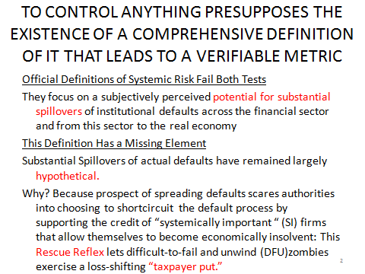

Slide 4
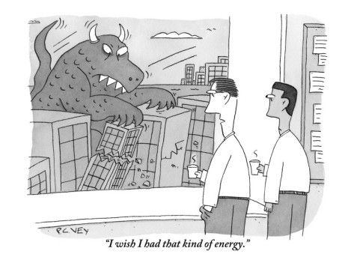
“When it comes to haircutting creditors and counterparties in horrific firms like AIG,
I wish our Regulators had the Courage of the Banks they are supposed to supervise.

Slide 5
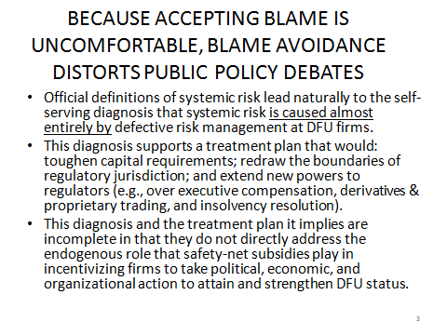

Slide 6
The per-period flow of safety-net benefits that a particular bank enjoys can be defined as a “fair” annual insurance premium percentage (IPP) expressed per dollar of the institution’s debt.
We interpret a firm’s systemic risk as the value of its option to “put” potentially ruinous losses and loss exposures to taxpayers. Its managers’ ability to trigger forbearance for capital shortages and stand-alone “tail-risk” (i.e., losses that exceed taxpayers’ value-at-risk supervisory protection) increases the value of the safety-net benefits it receives. This creates an incentive for managers to search out, to lobby for, and to exploit weaknesses (i.e., loopholes) in risk-control arrangements.

Slide 7

Bank and Regulatory Accounting Surface only the Tip of an Iceberg of Bailout Cost

Slide 8
BAILOUTS SHOULD BE RECOGNIZED AS A TAX-TRANSFER MECHANISM
To establish accountability, banks and governments need to be made to account for the way in which, when important firms fall deeper and deeper into distress, implicit and explicit taxpayer guarantees absorb much of the markdowns that would otherwise have to occur.
In accounting parlance, a contra-liability is an item that is entered on a firm's balance sheet when and to the extent that responsibility for servicing some of its debt falls on a third party. For banks, financial safety nets transform a block of unknown taxpayers into just such a third party. The unacknowledged value of taxpayer guarantees are, economically, an unbooked contra-liability of the modern commercial and investment bank and an unbooked, and uncertainly dated, liability of the taxpaying households and firms.

Slide 9
What Happens when a Ruinous Shock to Asset Value Hits One TBFU Bank?
Assets
100
Debt
(Guarantee )
Market Cap
80
95
1
6
6
1

Slide 10
What Happens to Balance Sheets of Taxpayers and Solvent Banks when Shock Hits their Assets and Three TBFU Banks?
Assets
500
Debt
TBTF Guarantees
Economic Net Worth
450
400
390 (due to limited debt relief)
3
2
97
28

Slide 11
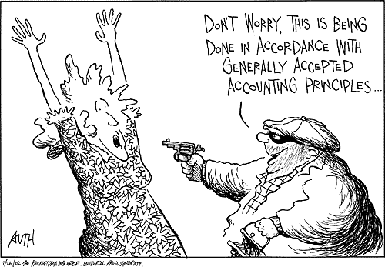
Economic Reporting Principles be Damned

Slide 12
We Model Safety-Net Benefits as a Function of the Volatility of Asset Quality and Capital Controls
Our modeling procedure follows Merton (1977) in portraying taxpayer credit support as a one-year European put option on the bank’s assets.. Merton portrays safety-net access as an option that allows bank owners to put the bank to safety-net managers for the face value of the bank’s debt. We allow authorities to refuse to exercise taxpayer’s side of the put (Kane, 1986).
[As observable input variables, our models use the book value of debt (B), the market value of a bank’s or bank holding company’s equity (E), the standard deviation of the return on equity (σ_{E}) and the fraction of bank assets distributed yearly as dividends to stockholders (δ). The synthetic variable IPP expresses the fair annual premium for stand-alone safety-net support per dollar of debt.]
Merton (1977, 1978) shows that the IPP increases both with a bank’s leverage and with the volatility of its return on assets. In Merton’s model, leverage is measured as the ratio of the par value (B) of deposits and other debt to the market value of a bank’s assets (V). Volatility is defined as the standard deviation of the return on bank assets (σ_{V}).

Slide 13
Unique features of our analysis: We distinguish a bank’s stand-alone risk from its systemic risk and we recognize that mischaracterizing insolvency issues as liquidity problems allows a flow of zombie-institution dividends to continue.

Slide 14
We conceive of IPP as the dividend that taxpayers would be paid on their contingent equity stake in a given firm if information asymmetries did not exist. The value of a bank’s “taxpayer put” increases with the extent to which creditors and stockholders are confident that they can scare or pressure authorities into shifting ruinous losses to taxpayers without adequate compensation.
We develop two different opportunity-cost measures of the costs of taxpayer support:
  The stand-alone IPP with prompt resolution: the IPD
  The systemic-risk IPP that incorporates an implicit estimate of likely forbearance: the IPDS.

Slide 15
Macroprudential Perspective
Over 1974-2010, we measure a bank’s contribution to systemic risk relative to the IPP that our model implies quarter by quarter for the portfolio of sample banks taken together.
A bank’s systemic risk (IPDS) is the difference between the IPD that arises for the “sectoral portfolio” when that particular bank is and is not included.

Slide 16
Table 4. Difference in Identity of Top Ten Sample Banks Ranked by Stand-Alone and Systemic Risk, 1974-2010
Panel A. Top 10 banks Ranked by Stand-Alone Risk
# | Bank | Regulatory or market response
1 | 1st Pacific Bancorp | Shut down
2 | Bay National Corp | Shut down
3 | Pacific State Bancorp/CA | Shut down
4 | First Bankshares Inc/VA | Acquired
5 | Community Shores Bank Corp | Consent order
6 | Crescent Banking Co | Shut down
7 | Ohio Legacy Corp | Consent order
8 | Sun American Bancorp | Shut down
9 | Bank of the Carolinas | Consent order
10 | Sterling Banks Inc | Shut down
Panel B. Top 10 banks Ranked by Systemic Risk
# | Bank | Fiscal Quarter | Assets ($ million)
1 | State Street Corp | 2009 Q1 | 142,144
2 | Wells Fargo & Co | 2009 Q1 | 1,285,891
3 | PNC Financial Services Group | 2009 Q1 | 286,422
4 | Trico Bancshares | 2008 Q3 | 1,976
5 | Regions Financial Corp | 2008 Q3 | 144,292
6 | Banctrust Financial Group | 2008 Q4 | 2,088
7 | Marshall & Ilsley Corp | 2009 Q1 | 61,790
8 | Bank of America Corp | 2009 Q1 | 2,321,963
9 | Pacwest Bancorp | 2008 Q4 | 4,496
10 | Frontier Financial Corp | 2008 Q3 | 4,245

Slide 17
Microprudential Perspective: Mean Value of IPD Using the Dividend-Forbearance Model for sample U.S. bank holding companies, 1974-2010 (quarter by quarter in basis points)

Slide 18
Figure 5. Macro Perspective: Sectoral Stand-Alone Risk Premium (IPD) for Sampled U.S. bank holding companies, 1974-2010 (quarter by quarter in basis points)

Slide 19
What Lessons Do These Graphs Teach?
Bank risk-taking increases in late booms and gets worked down again as economic recovery takes hold. Subsidies surged in every downturn.
Disguised Bank risk-taking increased markedly after the S&L mess. Megabankers recognized how reluctant authorities were to address a pattern of industry insolvency.
The Fed’s Pre-AIG/Lehman reluctance to conduct triage and impose immediate dividend stoppers in their 2007-2008 rescue programs cost taxpayers a lot on average.

Slide 20
Our Methods also show a Precrisis Buildup of Systemic Risk
Although Accounting and Tier-1 Capital Ratios were controlled, the Model-Implied ratio of market value capital went down sharply from 2006 on. The Lehman-AIG double U-Turn merely surfaced longstanding weakness.
Our straightforward and easy-to-calculate measures could have been used in potentially
“golden moments” to uncover and mitigate the last round of efforts to arbitrage capital requirements.

Slide 21
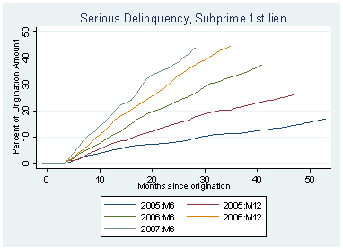
Golden Moments: Loans Got Worse and Worse As We Neared the Breaking Point

Slide 22
Figure 2. Mean Ratio of Model-Implied Equity Capital to Assets at Sampled U.S. bank holding companies, 1974-2010 (quarter by quarter in percent)

Slide 23
Macroprudential Perspective: Average correlation between returns on an individual bank stock and bank sectoral portfolio, 1974-2000 (by quarter number as a decimal fraction).

Slide 24
Figure 7. Mean individual-bank systemic risk premium (IPDS) at sampled U.S. bank holding companies using the Dividend-Forbearance Model, 1974-2010 (quarter by quarter in basis points)

Slide 25
Figure 8. Mean systemic risk premium (IPDS) using the Dividend-Forbearance Model at the top 5% of sampled U.S. bank holding companies, 1974-2010 (quarter by quarter in basis points)

Slide 26
CONCLUSION
Along with ordinary taxpayers, small banks have been supporting rather than exploiting the safety net. Anticipated increases in explicit and implicit premiums from post-crisis re-regulation are expected to fall proportionately more heavily on small banks.

Slide 27
Validation: Comparison of Our Measures of Stand-Alone and Systemic risk with two other measures of capital shortage for 18 of the 19 institutions that the Federal Reserve Subjected to Stress Tests in early 2009
 | Other Measures |  |  | Our Measures
 | SCAP ($Bil) | SCAP/Tier1 Capital | Acharya et al. MES ($Bil) | Value of Stand-alone Support ($MM) | Stand-alone Risk Premium IPD (bp) | Value of Systemic Risk Support ($MM) | Systemic Risk Premium IDPS (bp)
Bank of America Corp | 33.9 | 19.57% | 15.05 | 127300 | 619 | 40882 | 199
Wells Fargo & Co | 13.7 | 15.86% | 10.57 | 73645 | 617 | 40186 | 337
Citigroup Inc | 5.5 | 4.63% | 14.98 | 41073 | 232 | 37577 | 212
Regions Financial Corp | 2.5 | 20.66% | 14.80 | 11692 | 916 | 2265 | 177
Suntrust Banks Inc | 2.2 | 12.50% | 12.91 | 12690 | 800 | 3986 | 251
Keycorp | 1.8 | 15.52% | 15.44 | 4662 | 521 | 1912 | 214
Morgan Stanley Dean Witter & Co | 1.8 | 3.81% | 15.17 | 5100 | 80 | 8418 | 133
Fifth Third Bancorp | 1.1 | 9.24% | 14.39 | 34300 | 3240 | 3173 | 300
PNC Financial Services GRP INC | 0.6 | 2.49% | 10.55 | 8249 | 319 | 5881 | 228
American Express Co | 0 | 0.00% | 9.75 | 4489 | 433 | 2755 | 266
Bank New York Inc | 0 | 0.00% | 11.09 | 985 | 56 | -8965 | -510
JPMorgan Chase & Co | 0 | 0.00% | 10.45 | 23715 | 126 | 16893 | 90
US Bancorp | 0 | 0.00% | 8.54 | 8302 | 343 | 6021 | 249
State Street Corp | 0 | 0.00% | 14.79 | 4204 | 297 | 2109 | 149
BB&T Corp | 0 | 0.00% | 9.57 | 4491 | 326 | 3197 | 232
Capital One Financial Corp | 0 | 0.00% | 10.52 | 13137 | 896 | 2156 | 147
Goldman Sachs Group Inc | 0 | 0.00% | 9.97 | 2047 | 25 | 10407 | 125
Metlife Inc | 0 | 0.00% | 10.28 | 6960 | 144 | 6376 | 132
Notes: SCAP is the capital shortfall calculated in the supervisory Capital Assessment Program conducted in February 2009 and MES is the Marginal Expected Shortfall calculated by Acharya et al. (2010) from data in periods during which stock-market returns lie below their fifth percentile.

Slide 28
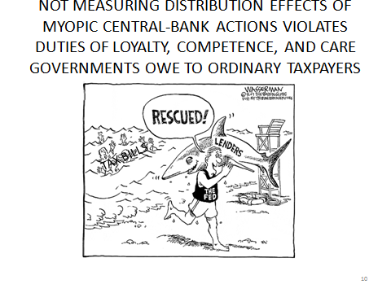

Slide 29
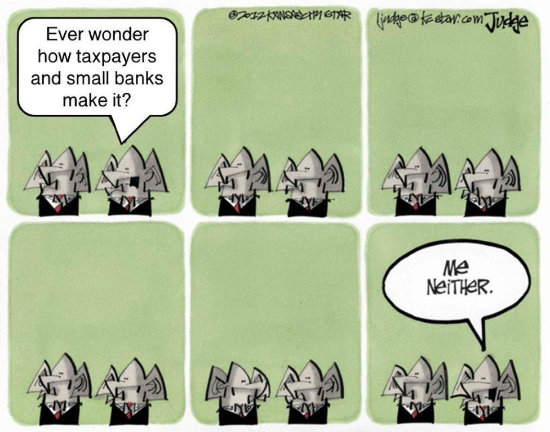
Bailout Policymaking in US & EU
Ever wonder how taxpayers and small banks will pay for megabank rescues?

