Slide 1
Comments on “Efficiency of Public Expenditure on Education in Croatia” by Petar Sopek
Menzie Chinn
Univ. of Wisconsin, Madison and NBER
Young Economists’ Seminar
18th Dubrovnik Economic Conference
Croatian National Bank
27 June 2012

Slide 2
Outline
Policy issue
The question asked
Results
Suggestions

Slide 3
The Policy Issue: Investment in Human Capital

Slide 4
The Question Asked
Narrowly: For given expenditures as share of GDP, how well is Croatia doing in terms of output, measured as PISA scores?
More generally: Measuring technical efficiency, assuming at least some observations are on the frontier.

Slide 5
One Input/One Output Model

Slide 6
Taking into account price levels
Public expenditure on education as a percentage of GDP does not take into account some important variables like total number of students or country standard and therefore may be unsatisfactory in efficiency measurement. Much better in this manner seems public expenditure on public educational institutions per pupil/student in EUR PPS, which measures how much central, regional and local levels of government spent per pupil/student, taking into account country standard weighted with Purchasing Power Standard (PPS).

Slide 7
Adjusted spending

Slide 8
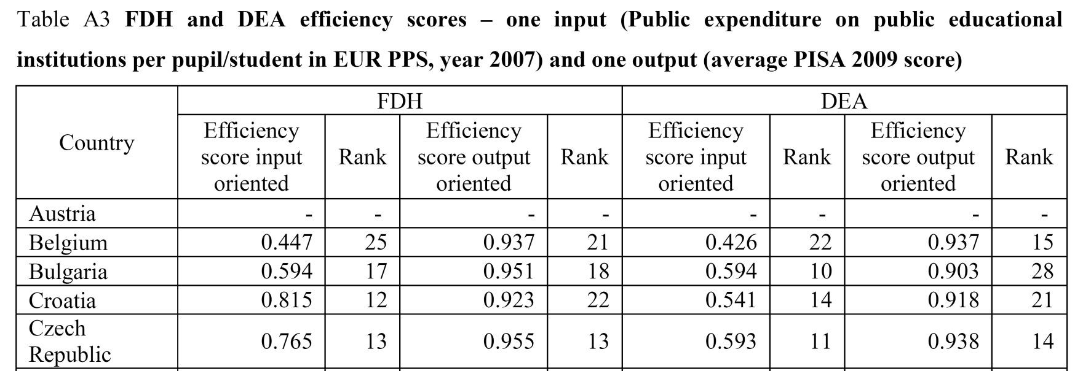
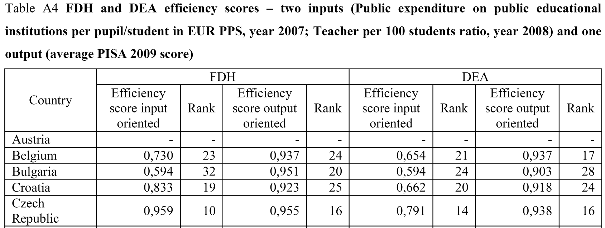
Two inputs/One output

Slide 9
Suggestions
Why FDH vs. DEA? What are the advantages and disadvantages (FDH is free disposal hull).
The discussion of why the inefficiencies is reasonable
But why not formally test source of “inefficiencies”
Regress estimated input or output inefficiencies on suspect variables, e.g.,
- Legatum index
- Urbanization
- Transport infrastructure
- Demographics

Slide 10
Suggestions (II)
DEA is highly sensitive to measurement error
DEA is sensitive to input and output specifications (as well as sample size)
Robustness checks would be advisable

Slide 11
Conclusion
Very interesting paper, applying a reasonable methodology
Would like more discussion of weaknesses/strengths DEA vs. FDH vs. regression approaches
Robustness tests
Formal assessment of the sources of “inefficiencies”

