Slide 1
A QUARTER CENTURY OF TRANSITION
HOW FAR HAVE COUNTRIES GONE, HOW WELL HAVE THEY PERFORMED?
Oleh Havrylyshyn
The George Washington University &
University of Toronto
(havrylyshyn@gwu.edu)

Slide 2
I. MOTIVATION AND PURPOSE

Slide 3
The aim of this presentation is to summarize the main developments in the transition of post-communist economies since the fall of the Berlin Wall in November 1989.
It is already well-known that different countries, indeed different groups of countries – vary in the degree of marketization (including privatization and capitalization), transformational recession, economic performance (such as GDP and exports), and political transformation.
Assessments of progress on the above dimensions have been done earlier (Havrylyshyn (2007), Svejnar (2001 ???), Roland (2014).
This paper provides an update to the earlier assessments, asking both how much further has transition gone, and whether the earlier conclusions hold or are changed by latest developments.

Slide 4
II. THE CATO INSTITUTE PAPER (2007)
(pp. 4-23 of distributed paper)

Slide 5
MAIN CONCLUSIONS
Rapid reforms were on the whole better than gradual reforms. Countries that adopted far-reaching reforms tended to experience higher growth rates and lower inflation and received more foreign investment. Inequality increased less among rapid reformers than among gradual reformers. The same is true with respect to poverty rates.
Rapid reformers developed better institutions than countries that opted for gradualism. In fact, all of the rapid reformers developed into liberal democracies, whereas in many of the gradual reformers, such as Russia, small groups of super-wealthy oligarchs captured the state and dominated its economic decision making.

Slide 6
III. UPDATE TO 2014 OF MAIN QUANTITATIVE INDICATORS

Slide 7
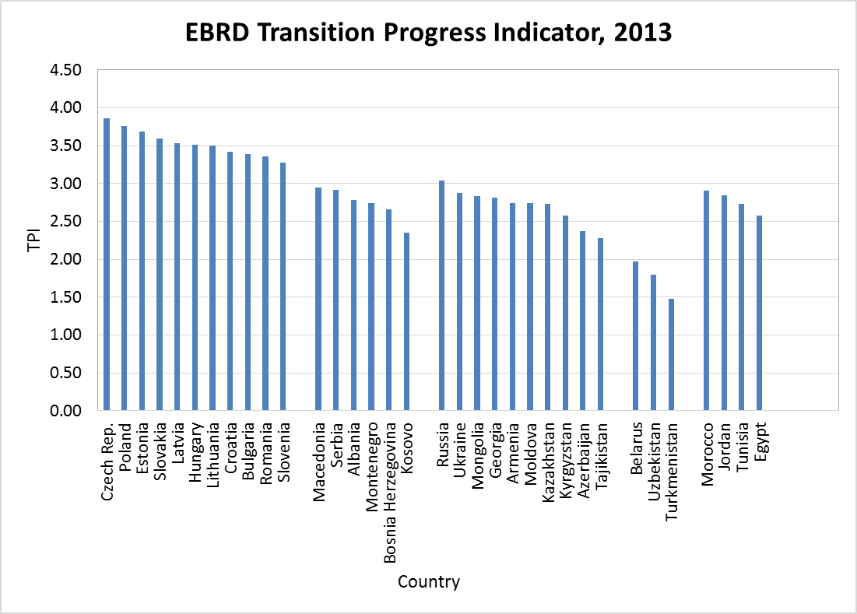
FIGURE 1a: Countries by Group and Rank Ordered By TPI in 2013

Slide 8
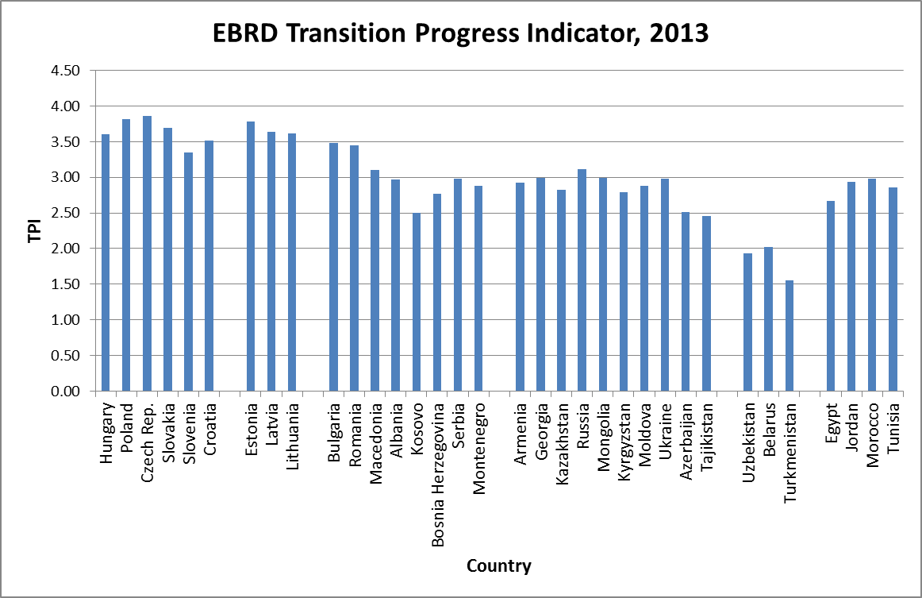
FIGURE 1b: by rank in 2007

Slide 9
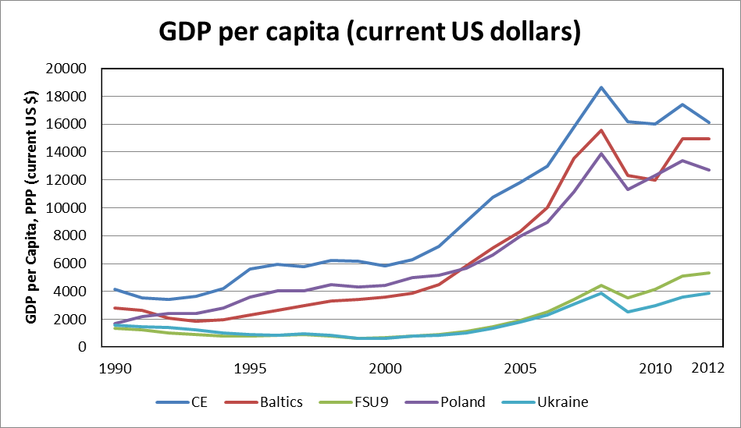
FIGURE 2: GDP per capita by Country Groups

Slide 10
TABLE 1: Average Cumulative FDI Inflows per capita 1989-2012 by Country Groups (US$)
Country Groups | Average Cumulative FDI Inflows per capita 1989-2012 (US$)
Central Europe | 5671.66
Baltic Countries | 7011.72
South-eastern Europe | 3399.86
FSUREF Countries | 1878.88
FSULAG Countries | 1888.17

Slide 11
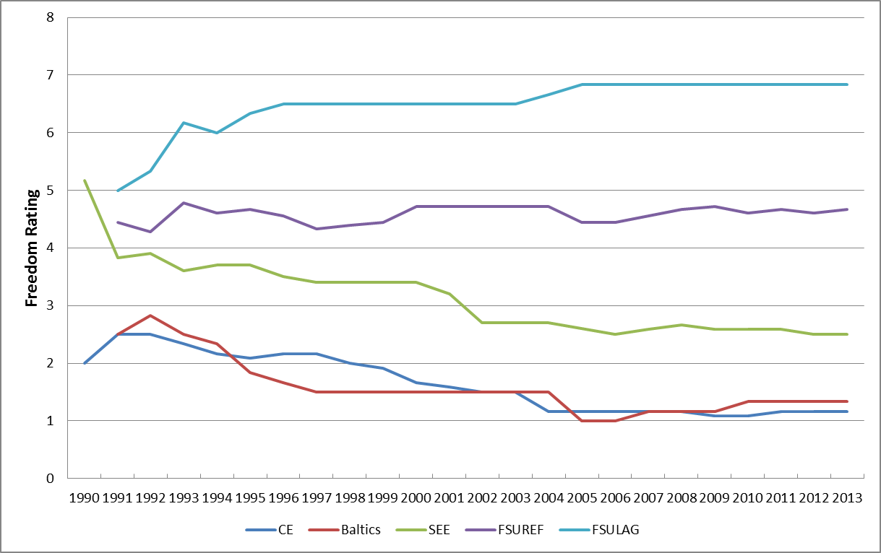
FIGURE 3: Freedom Rating by Country Groups (1990-2013)

Slide 12
TABLE 2: HDI Averages by Country Groups
Country groups: EBDR rank | 1990 | 1995 | 2000 | 2003
Central Europe (change from 1990) | .815 | .821 (+.006) | .861 (+.046) | .864 (+.049)
Baltic (change from 1990) | .812 | .779 (-.033) | .789 (-.023) | .847 (+.035)
SEE (change from 1990) | .752 | .749 (-.003) | .713 (-.039) | .793 (+.041)
CISM (change from 1990) | .772 | .721 (-.051) | .663 (-.109) | .730 (-.042)
CISL (change from 1990) | .767 | .743 (-.024) | .704 (-.063) | .739 (-.028)

Slide 13
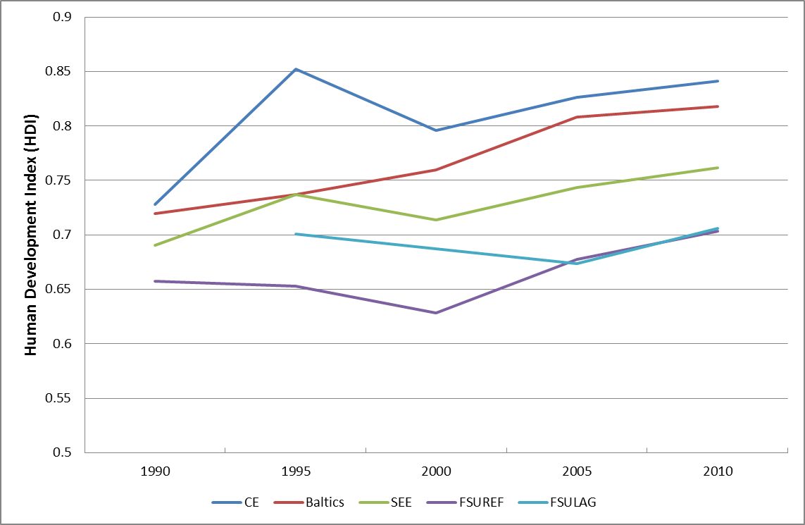
Figure 4: Average Human Development Index (HDI) by Country Groups

Slide 14
TABLE 3: Trends in GINI by Country Group
 | 1988-92 | 1993-6 | 2002-3
CE | 22 | 29 | 28
BALT | 25 | 35 | 36
SEE(3) | 21 | 27 | 33
CISM | 27 | 42 | 38
CISL | 25 | Na | 33
OECD | (low) | DNMRK | 25
 | (high) | USA | 40
DEVPG | (low) | INDNSIA | 30
 | (high) | COLOMB | 49
CHINA | Rural |  | 36
 | Urban |  | 32

Slide 15
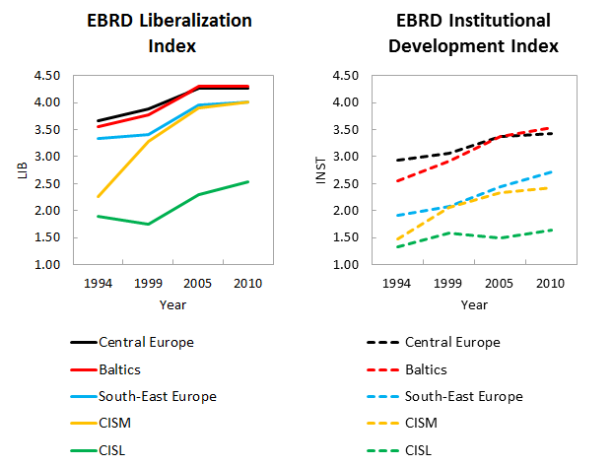
FIGURE 5: Actual Trend of Sequencing Liberalization and Institutional Development

Slide 16
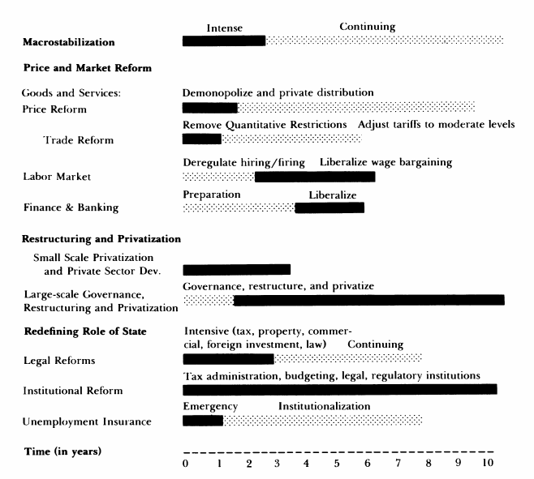
FIGURE 6: Washington Consensus as Per Wc Proponents

Slide 17
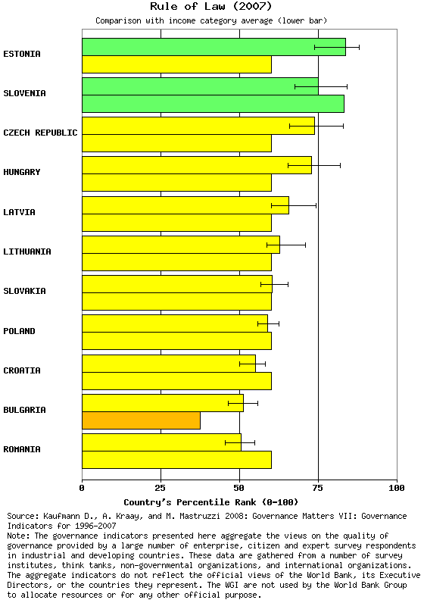
FIGURE 7: Rule-of-Law Score (Wb) New Member States

Slide 18
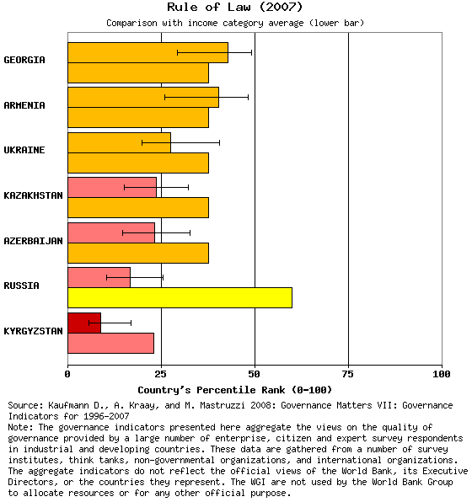
FIGURE 8: Rule of Law - FSU.9

Slide 19
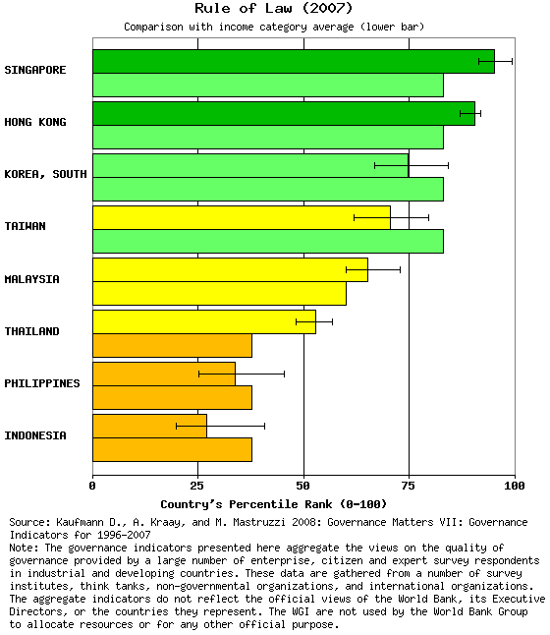
FIGURE 9: Rule-of-Law - East Asia

Slide 20
IV. CONCLUSIONS AFTER A QUARTER CENTURY OF TRANSITION

Slide 21
DIFFERENCE SINCE 2004
CONCLUSIONS LARGELY UNCHANGED FROM 2007 – CEB FAR AHEAD OF OTHERS, MANY CLOSE TO COMPLETING TRANSITION ; IN OTHER WORDS TRANSITION PROGRESS AND PATH ESTABLISHED EARLY, BY END OF FIRST DECADE
SOME EXCEPTIONS: SEVERAL FSU 9 CAUGHT UP TO SEE. (GEORGIA, MOLD, UNEVENLY UKRAINE )
IN C.E.-HU & SLVN ,FALL SLIGHTLY BEHIND
CONCLUSION THAT EARLY PATTERN LITTLE CAHMGED ALSO APPLIES TO VARIOUS INDICATORS ON INSTITUTIONS, GDP PERFORMANCE, FDI --- IMPORTANT EXCEPTION ON DEMOCRACY ( discussed in 3.)

Slide 22
KEY FINDINGS BY 2014
THE EARLIER STAB,LIB—FASTER RECOVERY AND GREATEST GDP CATCH-UP
FDI FAR GREATER FOR EARLY REFORMERS AND SURGE BEGAN WELL BEFORE ACCESSION IN 2004.
EARLIER STAB /LIB,-- LEAST S0CIAL PAIN [ but not necc. least unemployment ]
BEST MEASURE OF SOCAL IMPACT =HDI ; VARIED BY REGION
CE -SAW VERY LITTLE DECLINE IN HDI 1990-1995 , THEN A RAPID REBOUND AND BY 2000 SURPASSED 1990 VALUES
BALTICS-SLIGHTLY GREATER INITIAL DECLINE, BUT BY 2000 FULLY CAUGHT UP TO CE
LONGEST AND DEEPEST DECLINE IN ALL FSU
S.E.E.-- DETERIORATION ALSO IN NINETIES, BUT ATTRIBUTABLE TO BALKAN WARS, FROM 2000 RECOVERS

Slide 23
DEMOCRATIZATION PATHS DIFFERED SIGNIFICANTLY
EARLY ECONOMIC REFORMERS [CEB] ALSO UNDERTOOK EARLY AND SUBSTANTIAL DEMOCRATISATION , ALBEIT WITH SOME SMALL REVERSALS eg: SVK MID-90’S ; HU 2010>
IN DELAYED ECON. REFORMERS (FSU9 ,LAGGARDS (FSU3) , AND S.E.E.— LIMITED DEMOCRATIZATION TOOK PLACE AT START BUT MUCH LESS THAN CEB
WORSE :MOST FSU REVERSED ABOUT 2000-2005 TO RE-SOLIDIFY AUTHORITARIANISM
EXCEPTIONS –GEORGIA SIGNIFICANTLY MORE DEMOCRATIC SINCE 2002, UKR IN CYCLES OF PEOPLE REVOLUTIONS (ORANGE, EURO MAIDAN ); MOL QUIETLY WITHOUT COLOUR WITHOUT REVOLUTION , SLOWLY BETTER.

Slide 24
NEW CONCLUSIONS ON INSTITUTIONS
EARLY MARKET LIB DID NOT PREVENT OR POSTPONE GOOD INSTITUTIONS – INDEED COUNTRIES WITH EARLY STAB&LIB WERE ALSO FASTEST ON INST.
WHY ?? STRONG COMMITMENT TO REFORM LED TO QUICK LIB., LUSTRATION, STRONG DESIRES FOR “EU” -- “RETURN TO EUROPE “ – e.g. as put by Marti Laar Estonia. ”The little country that could“
GOOD BYE LENIN , AND JUST DO IT !!

Slide 25
COUNTRIES PROCLAIMING INTENT TO DELAY MARKET LIB IN ORDER TO DEVELOP FIRST GOOD INSTITUIONS –DID NOT DO THIS ; [ NOT ASINGLE CASE OF INST PRECEDING LIB.] . THEY WERE EVEN SLOWER ON ISTITUITONS THAN CEB:
LAST FACT RAISES SUSPICION THAT LEADER THERE WERE NOT SINCERE, COMMITTED TO REFORMS , BUT PURSUED RENT-SEEKING SELF INTEREST.
THIS IS NOT BECAUSE GRADUALIST THEORY WAS WRONG, BUT BECAUSE THOSE WHO WERE NOT COMMITTED TO SOCIAL WELL-BEING OF POPULACE WELFARE ABUSED POWER, MISUSED THEORY, MISLED POPULATION
RELEVANCE OF RAGUSA?? RAPID REFORMERS FOLLOWED RAGUSAN DICTUM ….. OBLITI PRIVATE, PUBLICA CURATE

Slide 26
INSTITUTIONAL REFORMS STALLED IN NEW MEMBERS?
OFTEN SAID THAT INST. REFORMS IN CEB, NEW EU MEMBERS SLOWED, STAGNATED, INCOMPLETE ( e.g. EBRD TR 2013)
NOT ENTIRELY CORRECT – ONLY TRUE IN ABSOLUTE MEASURE OF CHANGE OF TPI, YES, ANNUAL INCREASES OF TPI MUCH LESS IN 2005-2014 THAN IN FIRST FIFTEENYEARS – BUT THIS IS NOT A GOOD MEASURE OF SPEED OF CHJANGE IN CASE OF AN ASYMPOTIC CURVE!!
TECHNCALLY, TPI CURVE OVER TIME MOVES TO AN ASYMPTOTE = 4.3, HENCE AS IN MANY PHYSICAL AN SOCIAL PHENOMENA, BY DEFINITION THE ABSOLUTE ANNUAL CHANGE MUST BE DECLINING. FURTHER THE REAL SOCIAL POLITICAL PROCESS OF TRANSITION STARTS WITH LOW-HANGING FRUIT {STAB /LIB} WHICH CAN BE DONE QUICKLY, THEN MORE SLOWLY GOES ONTO THE COMPLEX, POLITICALLY DIFFICULT “ 2ND GEN REFORMS “

Slide 27
I AM SORRY TO BRING THIS NEWS TO CRITICS OF THE WASHINGTON CONSENSUS, BUT THE ACTUAL PATTERN FOR LEADING REFORMERS (=BEST PERFORMERS) IS QUITE SIMILAR TO THE CONCEPTUAL CHARTS OF THE WC (Fischer.Gelb)
REGARDLES OF EBRD ASYMPTOTE VALUE OF 4.3, OTHER INDICATORS OF INST DEV. - LIKE WB GOVERNANCE INDICATORS SUGGEST CEB COMPARES VERY WELL TO ASIAN TIGERS – I WOULD CONCLUDE THEY ARE THUS MORE OR LESS WHERE THEY SHOULD BE – INCOMPLETE YES, BUT VERY ADVANCED

Slide 28
THANK YOU!

