Slide 1

Socialist Growth Revisited: Insights from Yugoslavia
Leonard Kukić
London School of Economics, Department of Economic History

Slide 2
Introduction (I)
Successor states of Yugoslavia have essentially stagnated over the past 30 years.
Diverging European economic development after WWII had attracted much public interest. Not academic interest necessarily.
Planned economies performed relatively well in the 1950s and the 1960s.
In the 1980s their performance turned dismal.
(Usual) Explanation: Growth based on capital and labour expansion, and the transfer of resources from farms to factories, intrinsically limited (Krugman, 1995).

Slide 3
Introduction (II)
Failure of planned economies mostly attributed to embedded inefficiencies.
Doom argument: Employers and employees faced poor incentives since property was state owned (Bardhan and Roemer, 1993).
Nuanced argument: performance was relatively OK during mass production technology of the 1950s/1960s. But bad with onset of flexible production technologies during late 1970s (Broadberry and Klein, 2011) .

Slide 4
Motivation (I)
Existing literature suffers from two problems.
1st Problem: Excessive focus on Soviet Union.
Masks heterogeneity of E. European countries.
I analyse Yugoslavia.
Yugoslavia was taken as an example of one of fastest growing countries in 1950-70s.
Thus, Balassa and Bertrand (1970) found Yugoslavia did better than the average of other 9 sample countries, in terms of output and TFP growth.
In AER, Horvat (1971) attributed this to Yugoslavia’s decentralised economic system.

Slide 5
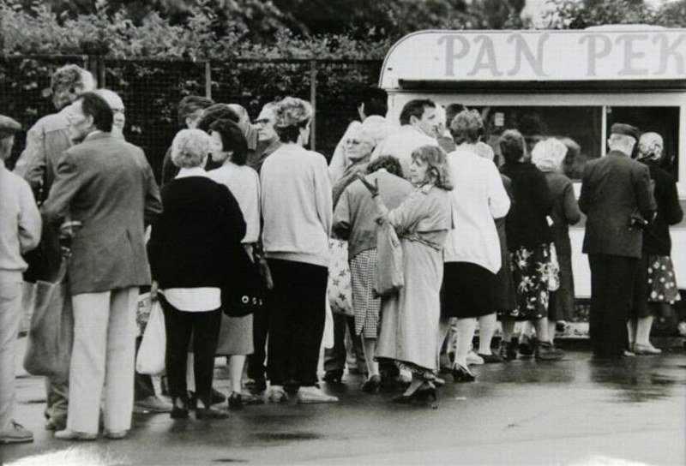
Motivation (II): 1980s

Slide 6
Motivation (III): The evolution of macroeconomic indicators in Yugoslavia and in the U.S., 1952-90.
Note: Capita is defined as working age person, while labour is defined as total hours worked ((average yearly hours worked per employee) x (total number of employees)). Hours worked per capita are total hours worked divided by the working age population.

Slide 7
Motivation (IV)
2nd Literature problem: Typically relies on a simple comparison of macro indicators, like productivity and growth (van Ark, 1996; Broadberry and Klein, 2011).
Hence, arguments not quantified or tested.
Some growth accounting exercises (Balassa and Bertrand, 1970; Vonyo, 2010). Very useful, but growth acc. suffers from its own problems.
So what can be done?

Slide 8
Motivation (V)
I apply business cycle accounting (BCA). Developed by Cole and Ohanian (2002) and Chari et al. (2007), among others.
BCA is a diagnostic tool like growth accounting, but moves towards explanations.
Hence, I can “explain” both the success and failure episodes.
BCA composed of two steps:
Calculate from data.
Insert wedges into a prototype model to determine their impact on econ. growth.
As a dynamic general equilibrium (DGE) model, confers two major advantages.
Adds a timing dimension.
Identifies the incentives that drive output, capital and labour.

Slide 9
Preview of results
1. TFP became more important over time in sustaining growth. Reconciles conflicting results in literature about relative importance of factors and TFP (Balassa and Bertrand, 1970; Weitzman, 1970; Sapir, 1980; Bergson, 1983; Kontorovich, 1986).
2. The labour wedge consistently deteriorated since the mid-1960s. And drove the collapse of growth during the 1980s.
Similar to findings of Weitzman (1970), Sapir (1980), and Easterly and Fischer (1995). But on completely different grounds.
Does not mean that technology and diminishing returns on capital were un-important. Rather, labour frictions were more important.

Slide 10
History
Evolution of socialist economic system can be divided into four phases. Gradual move from central planning, through market socialism, to decentralised planning.
1st Phase, 1947-1951: Rigid central planning focused on heavy industrialisation. Soviet Union Template.
2nd Phase, until 1965; Yugoslav officials sought to distance themselves from Soviet Union. Yugoslavia began gradually opening towards the West.
3rd Phase, until 1975: 1965 reform important. Heyday of market socialism. Economic power further decentralised to work councils within firms.
4rd Phase, until the end: 1974 constitution led to further decentralisation of power to the level of departments within firms.

Slide 11
History IV: Trade as per cent of GDP (1990 Int. GK$), and composition of trade, 1952-1988.
Note: This measure of openness can be considered real, since GDP is PPP adjusted. Trade means exports and imports of goods and services. Composition of trade, however, reefers to composition of trade in goods, due to data constraints.

Slide 12
History V: Western aid as per cent of GDP and gross investments (1990 Int. GK$), 1952-1965.

Slide 13
Methodology
BCA based on a standard Ramsay-Cass-Koopmans growth model.
Chari et al. (2007) argue that a large set of DGE models can be simplified through addition of “wedges”.
BCA developed for accounting for business cycle fluctuations. But can be applied to study episodes of economic growth (Lahiri and Yi, 2009; Lu, 2012; Chakraborty and Otsu, 2013; Cheremukhin et al., 2014.

Slide 14
Intuition (I)
BCA cannot identify the policies that effect the economy, bur rather the evolution of incentives that firms and households face.
Four wedges used are channels through which policies affect growth.
Taken together, they drive economic growth, and match data.
Labour wedge is related to incentives that determine the supply of labour.
Increasing labour wedge can be interpreted as an increase in the return for work effort.
Capital wedge is related to incentives that determine savings and investments, both physical and human capital.
Increasing capital wedge can be interpreted as an increase return on capital.

Slide 15
Intuition (II)
Income wedge embodies aggregate demand shocks stemming from G and NX.
Efficiency wedge (TFP) measures the efficiency with which inputs are transformed into output.
Drawbacks:
Wedges do not interact.
Can’t identify the exact incentives.

Slide 16
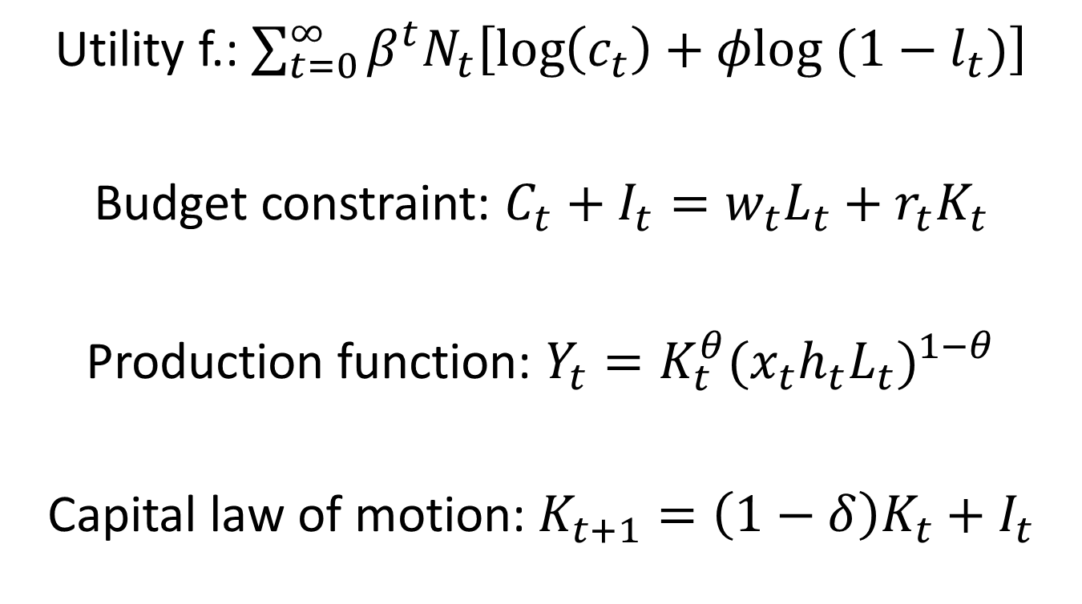
Prototype model: Setup
Utility f.:
Budget constraint:
Production function:
Capital law of motion:

Slide 17
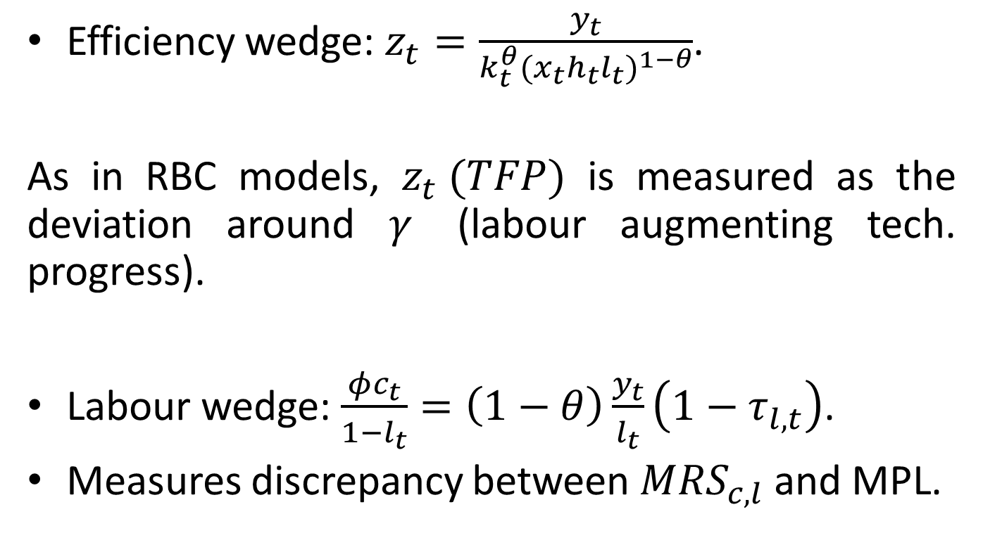
Equilibrium with wedges (I)
Efficiency wedge: .
As in RBC models, is measured as the deviation around (labour augmenting tech. progress).
Labour wedge: .
Measures discrepancy between and MPL.

Slide 18
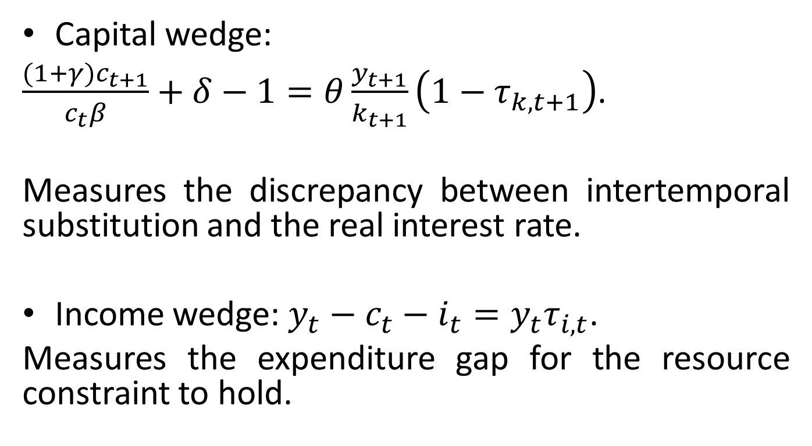
Equilibrium with wedges (II)
Capital wedge:
$\frac{(1+γ)c_{t+1}}{c_{t}β}+δ−1=θ\frac{y_{t+1}}{k_{t+1}}\left(1−τ_{k,t+1}\right)$.
Measures the discrepancy between intertemporal substitution and the real interest rate.
Income wedge: $y_{t}−c_{t}−i_{t}=y_{t}τ_{i,t}$.
Measures the expenditure gap for the resource constraint to hold.

Slide 19
Data (I)
Official output series problematic (Social Product).
Services excluded (education, healthcare, government, and etc.).
But input from excluded services into other sectors included.
Gross inconsistency in the application of the Material Planning System.
Furthermore, official output growth inflated due to:
1. Index number problems (Gerschenkron, 1947).
2. Distorted prices (Staller, 1986).
3. Perhaps outright fabrication.
As such, I use output series from Maddison (2010). But created by Thad Alton et al. (1970, 1992).

Slide 20
Data (II)
Working age population (15-64), employment of social sector, and data on private farming employment taken from official sources.
Total yearly labour input de-trended by 3600.
Human capital initially approximated by average years of schooling from Barro and Lee (2013). I take their estimate for Serbia.
Avg. years of schooling turned into mincerian human capital as in Hall and Jones (1999).
Capital stock series problematic. Exclude an investment category called “other”.

Slide 21
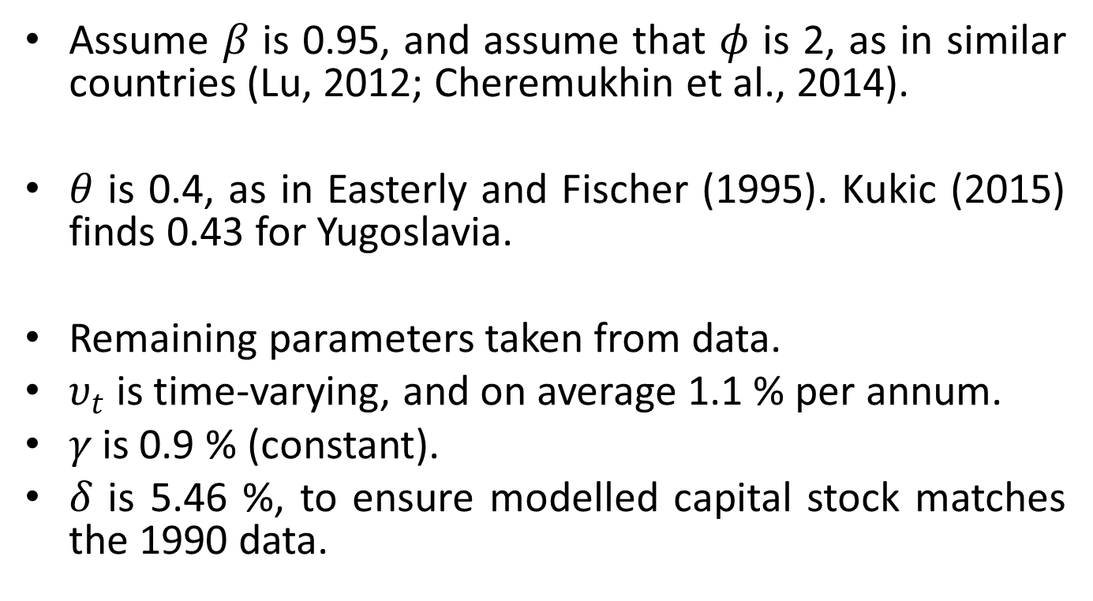
Calibration
Assume $β$ is 0.95, and assume that $φ$ is 2, as in similar countries (Lu, 2012; Cheremukhin et al., 2014).
$θ$ is 0.4, as in Easterly and Fischer (1995). Kukic (2015) finds 0.43 for Yugoslavia.
Remaining parameters taken from data.
$υ_{t}$ is time-varying, and on average 1.1 % per annum.
$γ$ is 0.9 % (constant).
$δ$ is 5.46 %, to ensure modelled capital stock matches the 1990 data.

Slide 22
Assumptions
1990 is the terminal period of wedges.
Profit maximisation is a poor description of socialist firms. But a socialist economy can be seen as a heavily distorted version of a perfectly competitive economy.
Cobb-Douglas assumption of unit substitution between capital and labour is problematic (Weitzman, 1970; Sapir, 1980; Easterly and Fischer, 1995).
Might be below one. If so, provides an elegant explanation for socialist growth - planned economies ran into acute diminishing returns on capital.

Slide 23

Results: The evolution and interpretation of wedges
Note: Business cycles have been cycled out using the Hodrick-Prescott filter (smoothing parameter = 6.25). No technological growth rate is imposed ($γ=0)$, rendering TFP growth comparable to standard growth accounting exercises.

Slide 24
Interpreting TFP (I)
Nishimizu and Page (1982) argue that TFP was driven by efficiency rather than technology. Similar to Hsieh and Klenow (2009).
Viable interpretations:
1. Reconstruction dynamics (Vonyo, 2008).
2. Structural change or improvements in sectoral allocation of resources (Lewis, 1954; Vollrath, 2009).

Slide 25
Interpreting TFP (II): Share of agricultural workers in total workforce in Yugoslavia, 1952-89

Slide 26
Interpreting TFP (III)
Trade might had boosted output through TFP (Alcala and Ciccone, 2004).
Yugoslavia did specialise according to its comparative advantage.

Slide 27
Interpreting labour wedge (I)
Hall (1997) argues labour wedge reflects frictions that lead households to spend a long time on non-market activities.

Slide 28
Interpreting labour wedge (II)
Mismatch between total hours worked and the working age population reflected in increasing unemployment.
Unemployment rate an average 8.2 per cent during 1967-75, rose to an average 12.6 percent during 1976-87.
Migration patterns not helpful.

Slide 29
Interpreting labour wedge (III)
Chari et al. (2007) argue that labour wedge can reflect distortions caused by monetary contraction (deflation) and trade unions (nominal wage rigidity).
In Yugoslavia during 1980s, real money balances halved (Bradley and Smith, 1991).
Labour managed firms under-invested, to pay out high(er) wages (Estrin, 1983).

Slide 30
Interpreting labour wedge (IV): Unit wage cost in efficiency units
Note: Unit wage cost is the ratio of the wage per worker to the GDP per efficiency unit of labour (labour productivity augmented by technology). For each year, the said ratio is divided by the same ratio of 1952. Wage rate has been deflated using the official output deflator.

Slide 31
Interpreting labour wedge (V): Labour unrest in Yugoslavia, 1958-89
Note: *1980 to 1989 shows data for Slovenia, a member republic of Yugoslavia.
Source: Stanojević (2003) for the frequency of strikes; Jovanov (1989) for the number of strikes and the number of workers involved; Lowinger (2009) for media reporting of strikes

Slide 32
Results (I): The contribution of wedges to economic growth

Slide 33
Results (II): The actual evolution of GDP per capita versus the counterfactual evolution of it (without TFP), 1952-89
Notes: The 1952 level of GDP per working age person is indexed to 100. If the two lines move in parallel, it means that the combined capital, labour and income wedges are responsible for most of economic growth.

Slide 34
Results (III): Simulations of GDP per working age person versus the actual GDP per working age person, 1952-89

Slide 35
Conclusion (I)
I hope I had filled a knowledge void.
TFP became more important.
Reconciles conflicting finding in the literature.
Labour frictions were the most important drag on growth.
Reconfirms older findings.
Natural step forward:
Determine the quantitative causality between policies and TFP and labour frictions.

Slide 36
Conclusion (II)
For TFP, trade might have been important.
More research needed to understand the incentive/ability of households to provide work effort.
Largely ignored so far.
Wages, driven by behaviour of labour-managed firms, might had led to deterioration of labour wedge in the 1960s and the 1970s, but not the 1980s.
Unemployment, and potentially labour unrest, seem important for the 1980s.

Slide 37
Appendix slides

Slide 38
Baseline wedges: Simulations of GDP per working age person versus the actual GDP per working age person, 1952-89

Slide 39
Baseline wedges: Actual and simulated I/Y, 1952-89

Slide 40
Non-agriculture: The actual evolution of Non-agricultural GDP per capita versus the counterfactual evolution of it (without TFP), 1952-89

Slide 41
Data parameters (Beta = 0.93, phi = 4.02): Simulations of GDP per working age person versus the actual GDP per working age person, 1952-89

Slide 42
Data parameters (Beta = 0.93, phi = 4.02): The actual evolution of GDP per capita versus the counterfactual evolution of it (without TFP), 1952-89

Slide 43
Linear leisure utility function: Simulations of GDP per working age person versus the actual GDP per working age person, 1952-89

Slide 44
Linear leisure utility function: The actual evolution of GDP per capita versus the counterfactual evolution of it (without TFP), 1952-89

Slide 45
Stone-Geary utility function: Simulations of GDP per working age person versus the actual GDP per working age person, 1952-89

Slide 46
Stone-Geary utility function : The actual evolution of GDP per capita versus the counterfactual evolution of it (without TFP), 1952-89

