Slide 1
Comments on
Davor Kunovac and Rafael Ravnik’s
“Are sovereign credit ratings overrated?”
Nauro Campos
Brunel University London
For presentation at
The 22nd Dubrovnik Economic Conference
June 12 2016

Slide 2
2 caveats to start
I will comment on the paper,
not on the presentation
(which as you could see was excellent)
I really liked the paper … a lot
(but I don’t teach/write about sovereign ratings)
(BTW great title!)

Slide 3
What does the paper do? 4 Q
do (sovereign credit) ratings affect (borrowing) costs (of European countries)?

Slide 4
What does the paper finds?
do (sovereign credit) ratings affect (borrowing) costs (of European countries)?
Answer: yes, not much but when junk threshold

Slide 5
What does the paper do?
do (sovereign credit) ratings affect (borrowing) costs (of European countries)?
what determines credit ratings (EU membs)?

Slide 6
What does the paper finds?
do (sovereign credit) ratings affect (borrowing) costs (of European countries)?
Answer: yes, not much but when junk threshold
(2) what determines credit ratings (EU membs)?
Answer: macro fund’tals and global risk

Slide 7
What does the paper do?
do (sovereign credit) ratings affect (borrowing) costs (of European countries)?
what determines credit ratings (EU membs)?
how much ratings agencies “meddle”?

Slide 8
What does the paper finds?
do (sovereign credit) ratings affect (borrowing) costs (of European countries)?
Answer: yes, not much but when junk threshold
(2) what determines credit ratings (EU membs)?
Answer: macro fund’tals and global risk
(3) how much ratings agencies “meddle”?
Answer: little (but is 10% really little?)

Slide 9
What does the paper do?
do (sovereign credit) ratings affect (borrowing) costs (of European countries)?
what determines credit ratings (EU membs)?
how much ratings agencies “meddle”?
do markets do it better?

Slide 10
What does the paper finds?
do (sovereign credit) ratings affect (borrowing) costs (of European countries)?
Answer: yes, not much but when junk threshold
(2) what determines credit ratings (EU membs)?
Answer: macro fund’tals and global risk
(3) how much ratings agencies “meddle”?
Answer: little (but is 10% really little?)
do markets do it better?
Answer: of course, markets always do it better

Slide 11
I have three main comments and many tiny ones
Main number 1 is this: You must deal properly with what you (perhaps mistakenly) call “political factors”
In each of the four exercises, there is a suggestion that this is a key omitted variable or worse
A suggestion:
Nick Bloom’s Economic Policy Uncertainty Index (http://www.policyuncertainty.com/index.html)

Slide 12
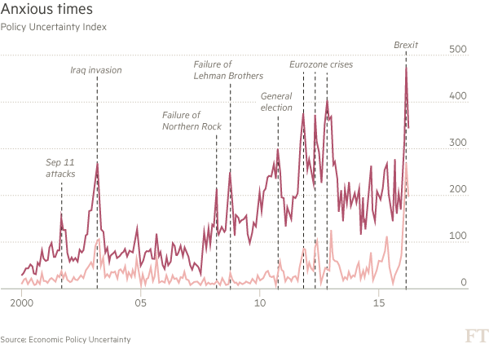

Slide 13
Main comment 2
Advice for whole paper:
Croatia is mentioned 3 times in the first paragraph
Why an Estonian/Spaniard/Californian who is reading this paper should be interested in Croatia?
Instead use country studies to illustrate regression results
Hw? Compare Croatia with Hungary and UK

Slide 14
Main comment 3
Make sure you provide estimation details
Which estimator is being used?
Number of observations????
How are ratings being used/entering the regressions?
All 3 agencies together?
What’s the correlation?

Slide 15
Now the small ones

Slide 16
Introduction
Currently, written as an executive summary
There are no references (academic/not) until page 6
1.1 Selected lit review, can it become a proper section? (pls cite a couple of surveys)

Slide 17
Section 2 Role of Rating Agencies
Summarise in one paragraph
And move the rest to an appendix
I imagine people that started to read this paper have an idea about what ratings agencies do

Slide 18
Section 3 (exercise 1, q1)
Needs major clarifications
23 EU countries, why/what happens the missing 5?
Are stock prices “measures of BC at daily freq”?
All 3 agencies together? Correlation?
Agencies job is to be Arbiter of Junk: discuss fully
What estimator?
Number of observations?

Slide 19
Section 4 (exercise 2, q2)
One year moving average for daily obs? Is this std?
At least Hausman test
Economic freedom vs Doing Biz is problematic, cf policy uncertainty index
Footnote 11: please fix: where is Table 8? Where are columns V and VI?
Needs major clarifications
Number of obs?
Use country studies to illustrate regression results: add to Croatia discussion (p19), eg Hungary and UK

Slide 20
Section 5 (exercise 3, q3)
The decomposition should be presented in a more careful and clear way
Maybe a technical appendix?
Use country studies to illustrate regression results: add to Croatia discussion (p23), eg Hungary and UK
Number of obs?

Slide 21
Section 6 (exercise 4, q4)
Rating agencies wrt market are delayed TWO years!
How does this compare to rest of lit?
Use country studies to illustrate regression results: add to Croatia discussion (p23), eg Hungary and UK
More details of estimation?
Number of obs?
PS Need to write proper Conclusion section

Slide 22
In summary
I really liked the paper
A number of interesting results
Major issues: lack of “policy uncertainty” measure
More details on estimation
More illustration of regression results using country case studies (Croatia, Hungary and UK)

