Slide 1
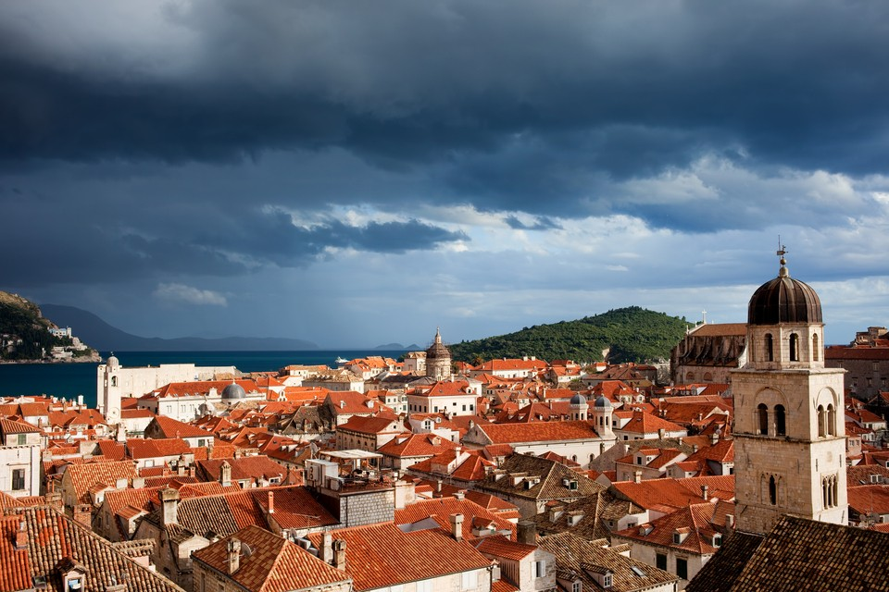
The Eurozone:
Gray Clouds, or
Silver Linings?
Arup Banerji
Regional Director,
European Union
The World Bank
DEC Dubrovnik
June 2016

Slide 2
Green shoots?
Silver linings or Gray clouds?
Red herrings?

Slide 3
Green shoots?
First indicators look encouraging
Silver linings or Gray clouds?
Red herrings?

Slide 4
Growth in the Eurozone picks up in Q1 2016
Source: Eurostat.
Note: CLV – Chain linked volumes; SCA – Seasonally and Calendar adjusted.

Slide 5
… Yet for more than half, this is a slight slowdown from Q4 2015
Source: Eurostat.
Note: CLV – Chain linked volumes; SCA – Seasonally and Calendar adjusted.

Slide 6
… An uptick in consumption and investment has been the driver of recent years’ growth

Slide 7
Even though low, investment contributes significantly to GDP growth in several Eurozone countries

Slide 8
Lower trade flows have marked 2016 as compared to 2015
Source: World Bank Global Economic Prospects June 2016

Slide 9
Still, World Bank projections show accelerated growth in 2016-18
Source: World Bank Global Economic Prospects June 2016

Slide 10
And as of December 2015, interest rate expectations are inching up
Source: World Bank Global Economic Prospects June 2016

Slide 11
Green shoots?
First indicators look encouraging
Silver linings or Gray clouds?
Potential for hysteresis?
Red herrings?

Slide 12
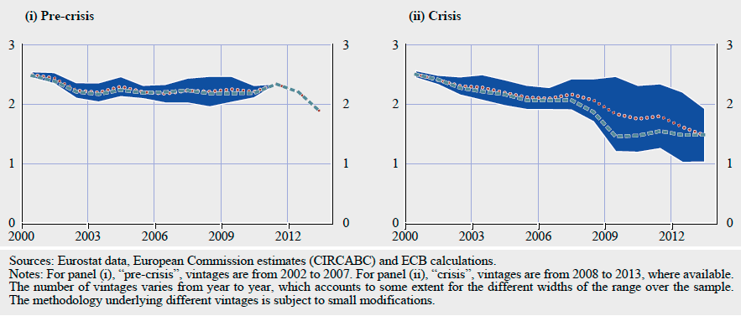
Potential Output Growth has Shrunk During the Crisis… Today, still Tending to Around 1%
Source: Anderton et al (2014)

Slide 13
Instead of investing, much of the private sector is deleveraging…
Source: AMECO

Slide 14
…And the public sector continues to amass debt
Source : Eurostat

Slide 15
And competitiveness is beginning to dip again
Source: ECB.
Note: A rise in the rate means a loss of competitiveness.

Slide 16
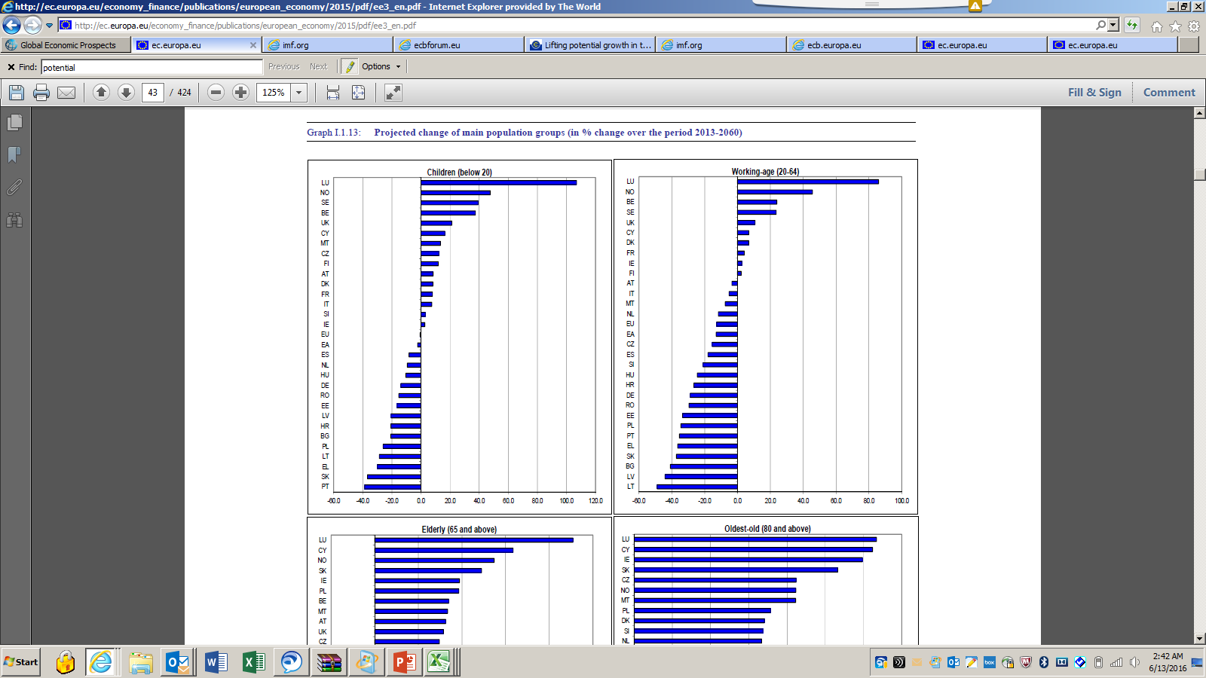
Demographic aging is decreasing the work force
Source: Eurostat – 2013-60 projections

Slide 17
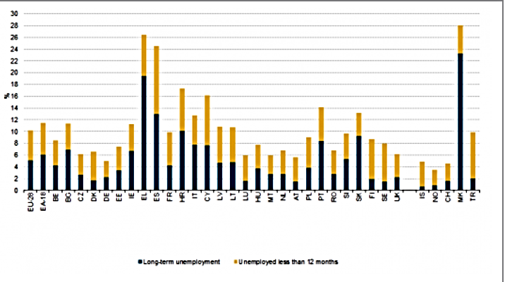
Long-term unemployment trends in many Eurozone countries show weak supply-side potential
Greece
Spain
Croatia
Portugal
Slovakia
Source: Eurostat – 2014 numbers

Slide 18
Unemployment rates are becoming leading indicators of consumer confidence in the Eurozone

Slide 19
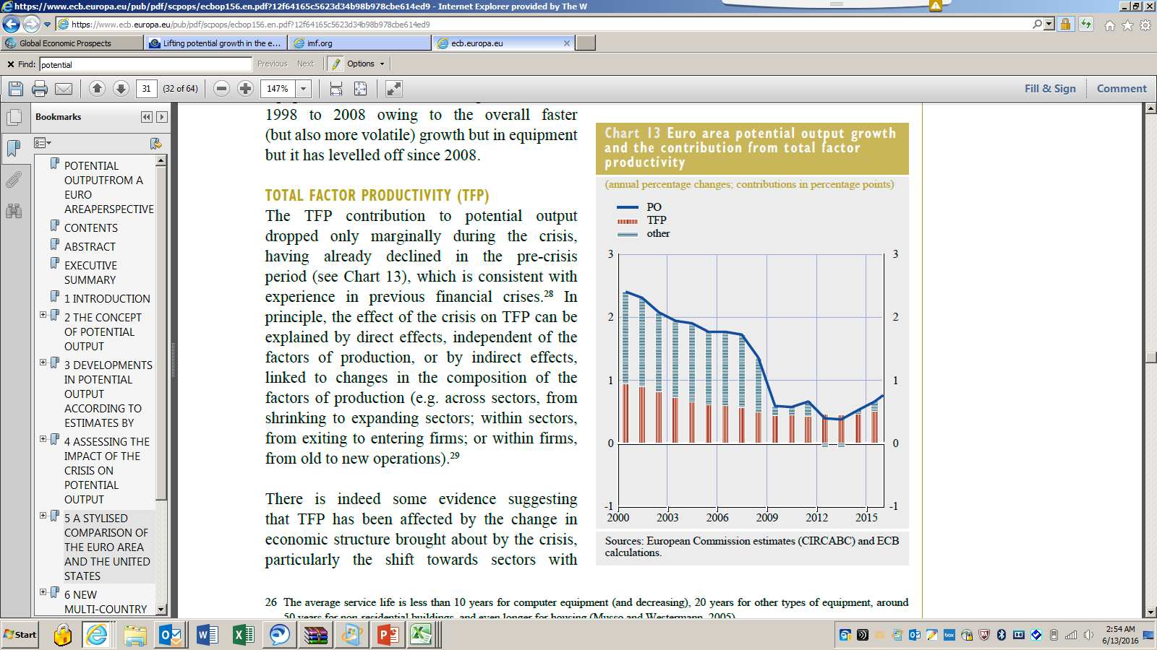
Total Factor Productivity is Shrinking, and so can’t boost Potential Output (PO)
Source: Anderton et al (2014)

Slide 20
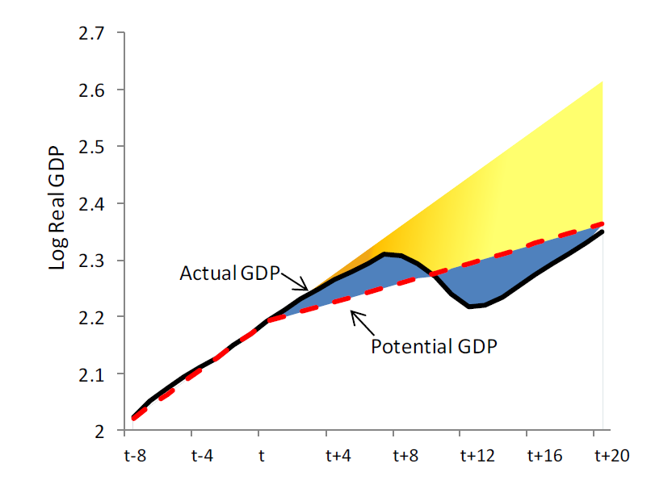
Is there underlying hysteresis?
Source: Blanchard, Cerutti and Summers (2016)

Slide 21
Structural reforms have slowed…
Source: OECD
Euro Area deficit countries are: Estonia, France, Greece, Italy, Ireland, Portugal, the Slovak Republic,
Slovenia and Spain.
Source: World Bank Global Economic Prospects June 2016

Slide 22
Green shoots?
First indicators look encouraging
Silver linings or Gray clouds?
Potential for hysteresis?
Red herrings?
Be a bit skeptical of forecasts!

Slide 23
As of December 2015, interest rate expectations are inching up
Source: World Bank Global Economic Prospects June 2016

Slide 24
Today, expectations are already flattening
Source: World Bank Global Economic Prospects June 2016

Slide 25
In fact, inflationary expectations have been perennially optimistic
Source: World Bank Global Economic Prospects June 2016

Slide 26
In fact, inflationary expectations have been perennially optimistic
Source: World Bank Global Economic Prospects June 2016

Slide 27
In fact, inflationary expectations have been perennially optimistic
Source: World Bank Global Economic Prospects June 2016

Slide 28
In fact, inflationary expectations have been perennially optimistic
Source: World Bank Global Economic Prospects June 2016

Slide 29
In fact, inflationary expectations have been perennially optimistic
Source: World Bank Global Economic Prospects June 2016

Slide 30
In fact, inflationary expectations have been perennially optimistic
Source: World Bank Global Economic Prospects June 2016

Slide 31
… and global (and EU) growth forecasts …
Source: World Bank Global Economic Prospects June 2016

Slide 32
… and global (and EU) growth forecasts have large confidence intervals!
Source: World Bank Global Economic Prospects June 2016

Slide 33
Thank You!
abanerji@worldbank.org
References:
Anderton et al (2014): “Potential Output from an Euro Area perspective”, https://www.ecb.europa.eu/pub/pdf/scpops/ecbop156.en.pdf?12f64165c5623d34b98b978cbe614ed9
Blanchard, Cerutti and Summers (2015): “Inflation and Activity – Two Explorations and their Monetary Policy Implications,” IMF WP/15/230
World Bank (2016): Global Economic Prospects: Divergence and Risk: http://www.worldbank.org/en/publication/global-economic-prospects
Notes:
Rebalancing of growth to more sustainable and inclusive growth in South-East Europe is already happening.

