Slide 1
“Currency Unions and Trade : A Post- EMU Reassessment” by Reuven Glick and Andrew K. Rose
Comments by Ricardo Lago
The 22nd Dubrovnik Economic Conference
June 13th , 2016

Slide 2
Comments
1. Control for different types of Monetary Union
2 . Discuss the experience of the Latin Monetary Union ( 1865 – 1927 )
3. Does EMU come at a cost ?
  In your paper you deal with the upside : 50% expansion of exports /imports
  Is there any downside ?

Slide 3
Comment 1 - Types of Currency Unions
  Informal
    Euro in Montenegro and Kosovo ( in 2001 )
    US$ in Ecuador ; El Salvador and East Timor ( all in 2000 )
  Formal
    ( US$ in Panama 1904 )
    US$ Former US Trust Territory of the Pacific ( Palau , Marshall , Micronesia )
    Euro in Andorra,Vatican , San Marino
  Formal with common monetary policy
    European Monetary Union
    Latin Monetary Union ( 1865- 1927 )

Slide 4
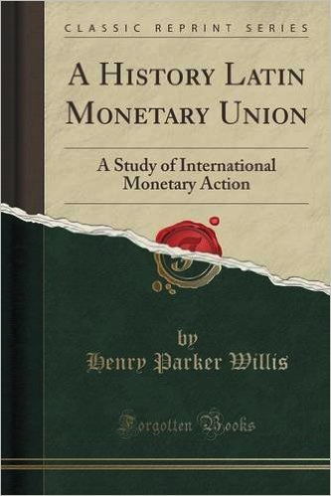
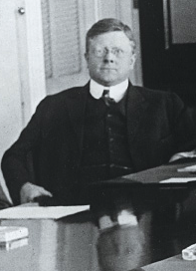
Comment 2 - The Latin Monetary Union

Slide 5
Greece in the Latin Monetray Union
Original Members were : France , Italy Belgium and Switzerland. Greece joined two years later
BBC : "its chronically weak economy meant successive Greek governments responded by decreasing the amount of gold in their coins”
Greece was expelled in 1908 for debasing the currency

Slide 6
Comment 3 - Does EMU come at a cost ?
Before Euro: Financial markets viewed peripheral countries as emerging markets
  Devaluation – Inflation – High interest rates
After Euro : Markets assume that the credit risk of the peripheral countries was almost as good as Germany
Peripheral countries embarked on an unprecedented “spending binge”

Slide 7
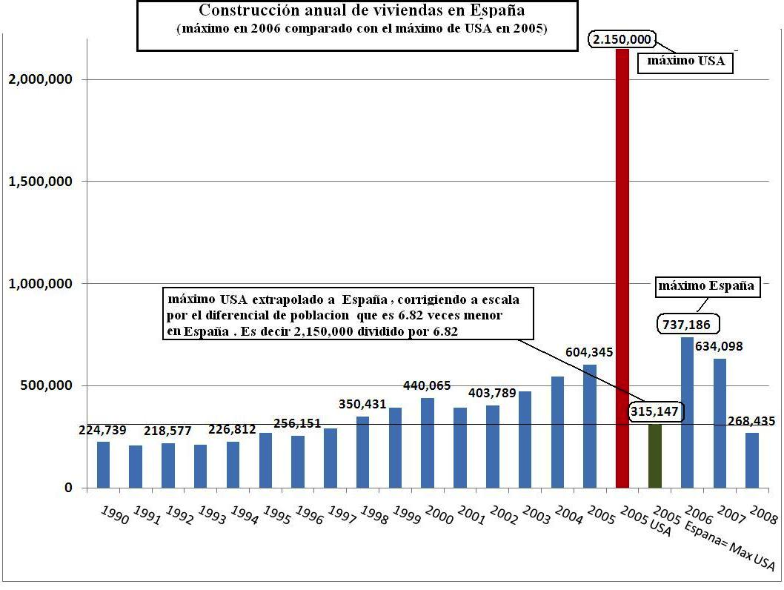
Let me illustrate the spending binge with the
Spanish housing boom

Slide 8
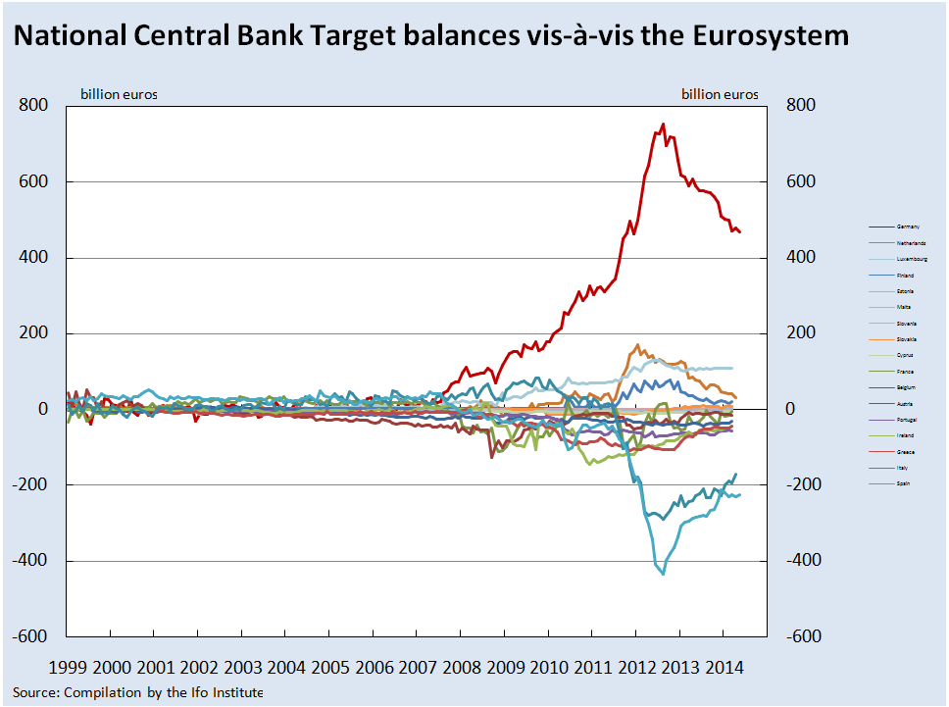
Capital flight in 2012- II

Slide 9

Whatever it takes
“ whatever it takes to preserve the euro. And believe me, it will be enough”

Slide 10
Adjustment post-2009 and post-2012 ?
Debt dynamics
No primary surplus with the exception of Italy
Paul Romer : “A crisis is a terrible thing to wast”

Slide 11
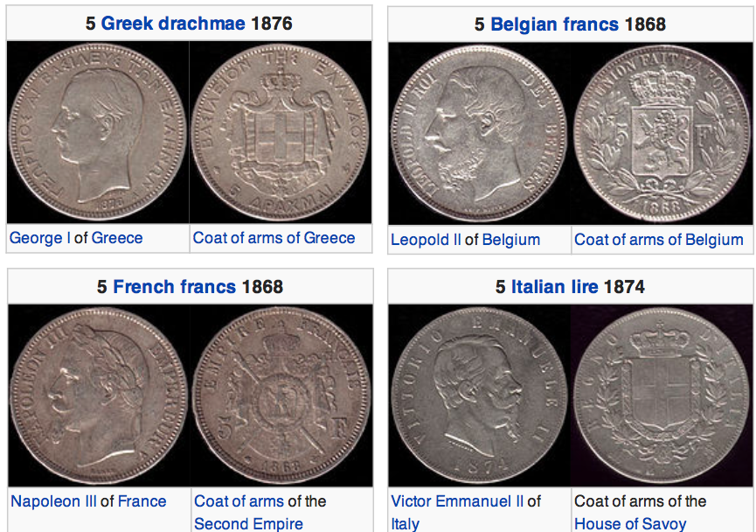
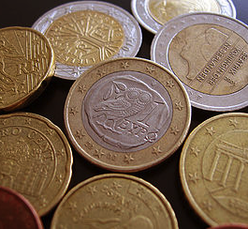
Will EMU survive or will it be another romantic experiment as the Latin Monetary Union ?
Latin Monetary Union
European Monetary Union

Slide 12


Slide 13
The End

