Slide 1

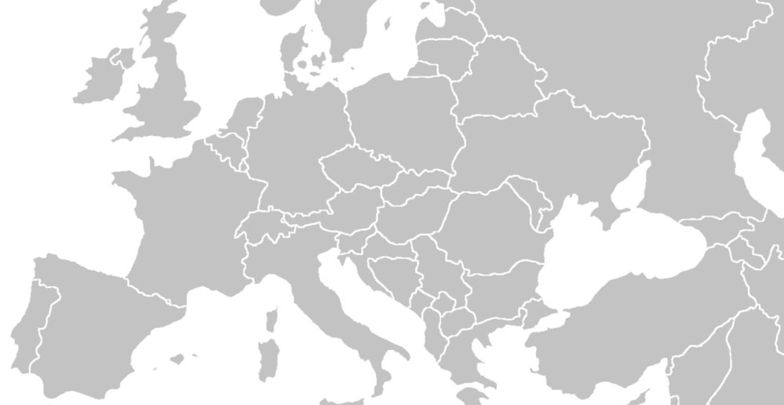
INTERNATIONAL MONETARY FUND
Are we really out of the woods?
Poul M. Thomsen
Director, European Department
International Monetary Fund
June 13, 2016

Slide 2

Euro area Recovery Continues but medium-term outlook lackluster
European Department, International Monetary Fund

Slide 3
Crisis Legacies – Unemployment still high
European Department, International Monetary Fund

Slide 4
Crisis Legacies – Slow progress in deleveraging
European Department, International Monetary Fund

Slide 5
Lagging structural Reforms, Low Potential Growth
European Department, International Monetary Fund

Slide 6
External imbalances persist
European Department, International Monetary Fund

Slide 7
Weak growth outlook leaves high-debt countries vulnerable
European Department, International Monetary Fund

Slide 8
limited policy buffers to Absorb Shocks
European Department, International Monetary Fund

Slide 9
more balanced policy mix needed
To bolster growth and strengthen the union
Strengthen governance to incentivize
structural reforms
Risk sharing and risk reduction in financial sector, incl. balance sheet deleveraging
Use of fiscal space/SGP flexibility and centralized investment
Continued monetary policy accommodation
Comprehensive approach
European Department, International Monetary Fund

Slide 10
Falling support for the eu
Actions needed to rebuild trust
European Department, International Monetary Fund

Slide 11
INTERNATIONAL MONETARY FUND
Thank you
June 13, 2016

